Slide 1
Distributed Capacity Procurement
Scaling DERs into Reliable Grid Resources

Slide 2
Distributed Capacity Procurement
Aims of the DCP White Paper
Introduce and define the Distributed Capacity Procurement Model. Clarify how DCP compares to and differs from traditional virtual power plants, demand response, and demand-side management programs. Describe how utility-led DERs can serve as gridscale planning, infrastructure, and capacity resources. Outline the economic case for DCP. Provide a roadmap for utilities and regulators to implement DCP.
Notes:
Growing Variable Renewable Energy Generation:
The shift toward renewable energy, driven by improved economics and state and utility decarbonization goals, introduces variability into the grid and uncertainty into grid planning and operations. Solar and wind power are intermittent and require more sophisticated management strategies to ensure grid stability.
Increasing Electricity Demand:
Electricity demand is growing due to increasing data center load, industrialization, and the electrification of buildings and transportation. This increased demand places additional stress on the distribution grid, necessitating advanced management and optimization techniques.
DER Adoption:
The adoption of DERs, including rooftop solar panels, batteries, electric vehicles (EVs), and smart home devices, is transforming the traditional grid. Customers are no longer just consumers of electricity; they also use the grid more intensively and in ways not contemplated in the past by producing, storing, and dispatching energy.
Grid Resilience:
Increasingly extreme and costly weather events can threaten the reliability and stability of the electric power system. Utilities are turning to grid-scale and customer-sited distributed generation and storage, in addition to traditional resilience solutions, such as grid hardening, undergrounding lines, and vegetation management to provide options for grid resilience.
According to a Brattle Group study, the net cost to a utility of providing resource adequacy from a VPP is roughly 40–60% of the cost of conventional options like natural gas peaker plants or utility-scale batteries.
Beyond cost savings, VPPs can also help meet resource adequacy needs faster than traditional alternatives; whereas traditional generation can take years to build and even longer to interconnect, VPPs can be launched and scaled in a matter of months.

Slide 3
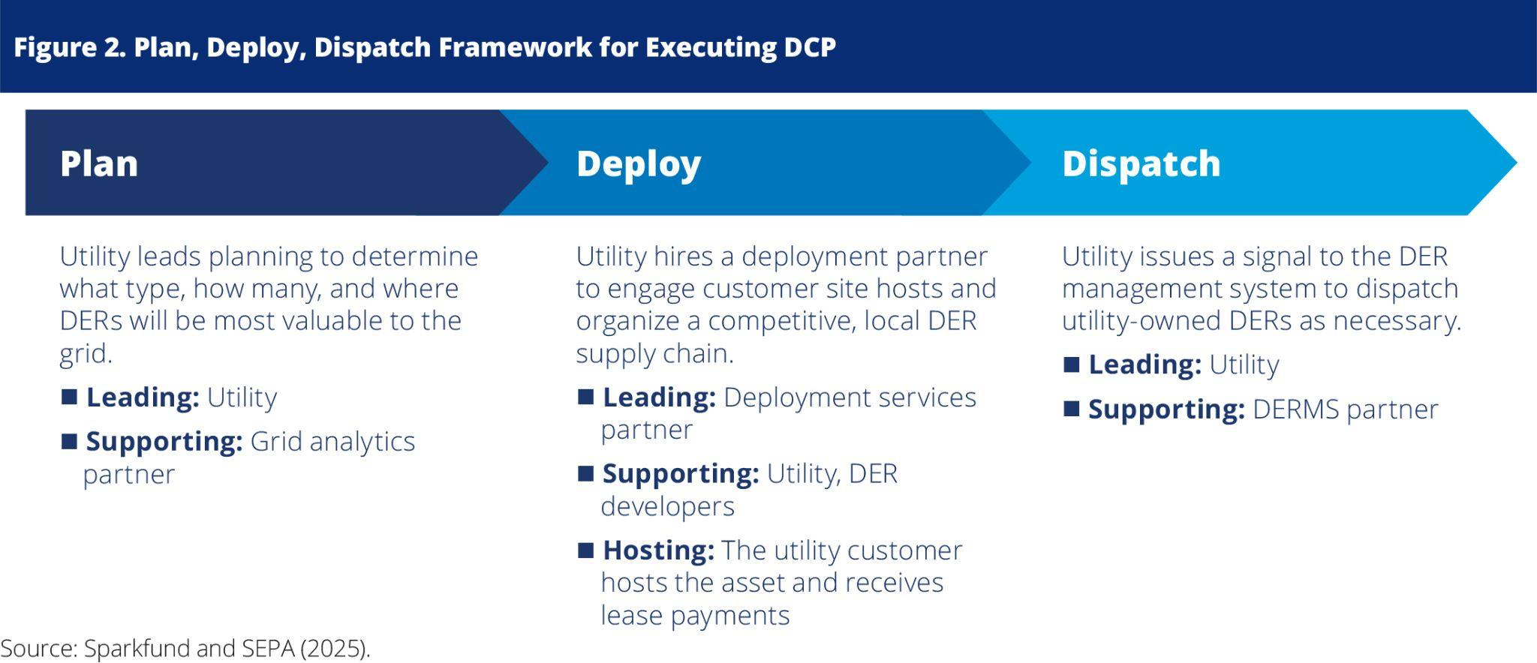
Plan, Deploy, Dispatch Framework
Notes:
VPPs are also gaining regulatory momentum. In 2024, 105 state and investor-owned utility (IOU) regulatory actions supporting VPPs and distributed energy resources (DERs) were implemented across 37 states and Washington, D.C. These regulatory developments will accelerate deployment of flexible technologies, especially as nearly three-quarters (72%) of utility leaders report that regulatory compliance and mandates are the primary driver of innovation within their organizations.
Policy and regulatory momentum has continued apace in 2025, as the figure shows. Most notably, many of the states with the largest demand growth from data centers and industrialization, like Virginia, Georgia, and Louisiana have seen legislation, regulatory action, or new program filings.

Slide 4
What DCP is Not
DCP is not a traditional utility construction model where utilities build DERs using their own in-house engineering and construction resources. DCP relies on competitive bidding from local DER companies. DCP does not eliminate or preclude private ownership of DERs, as both utility- and customer-owned distributed resources can coexist within the same energy ecosystem. DCP is not a broad, demand-side management customer program open to all ratepayers; instead, it is strategically and geographically targeted to address specific infrastructure needs of the grid.
Notes:
VPPs are also gaining regulatory momentum. In 2024, 105 state and investor-owned utility (IOU) regulatory actions supporting VPPs and distributed energy resources (DERs) were implemented across 37 states and Washington, D.C. These regulatory developments will accelerate deployment of flexible technologies, especially as nearly three-quarters (72%) of utility leaders report that regulatory compliance and mandates are the primary driver of innovation within their organizations.
Policy and regulatory momentum has continued apace in 2025, as the figure shows. Most notably, many of the states with the largest demand growth from data centers and industrialization, like Virginia, Georgia, and Louisiana have seen legislation, regulatory action, or new program filings.

Slide 5
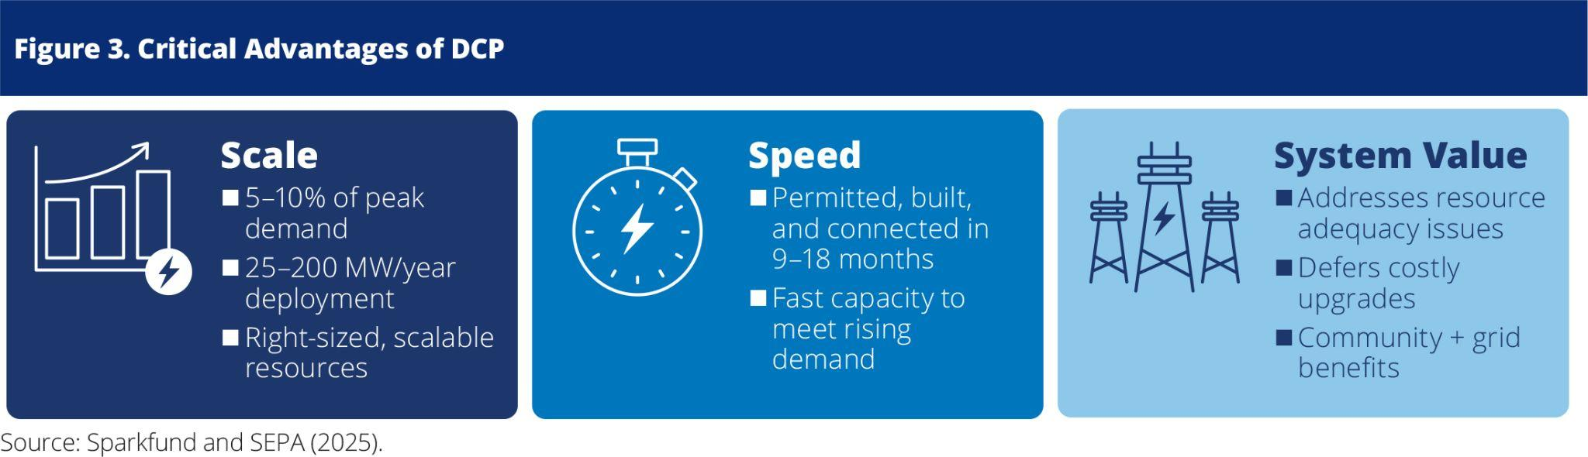
Critical Advantages of DCP
Notes:
VPPs are also gaining regulatory momentum. In 2024, 105 state and investor-owned utility (IOU) regulatory actions supporting VPPs and distributed energy resources (DERs) were implemented across 37 states and Washington, D.C. These regulatory developments will accelerate deployment of flexible technologies, especially as nearly three-quarters (72%) of utility leaders report that regulatory compliance and mandates are the primary driver of innovation within their organizations.
Policy and regulatory momentum has continued apace in 2025, as the figure shows. Most notably, many of the states with the largest demand growth from data centers and industrialization, like Virginia, Georgia, and Louisiana have seen legislation, regulatory action, or new program filings.

Slide 6
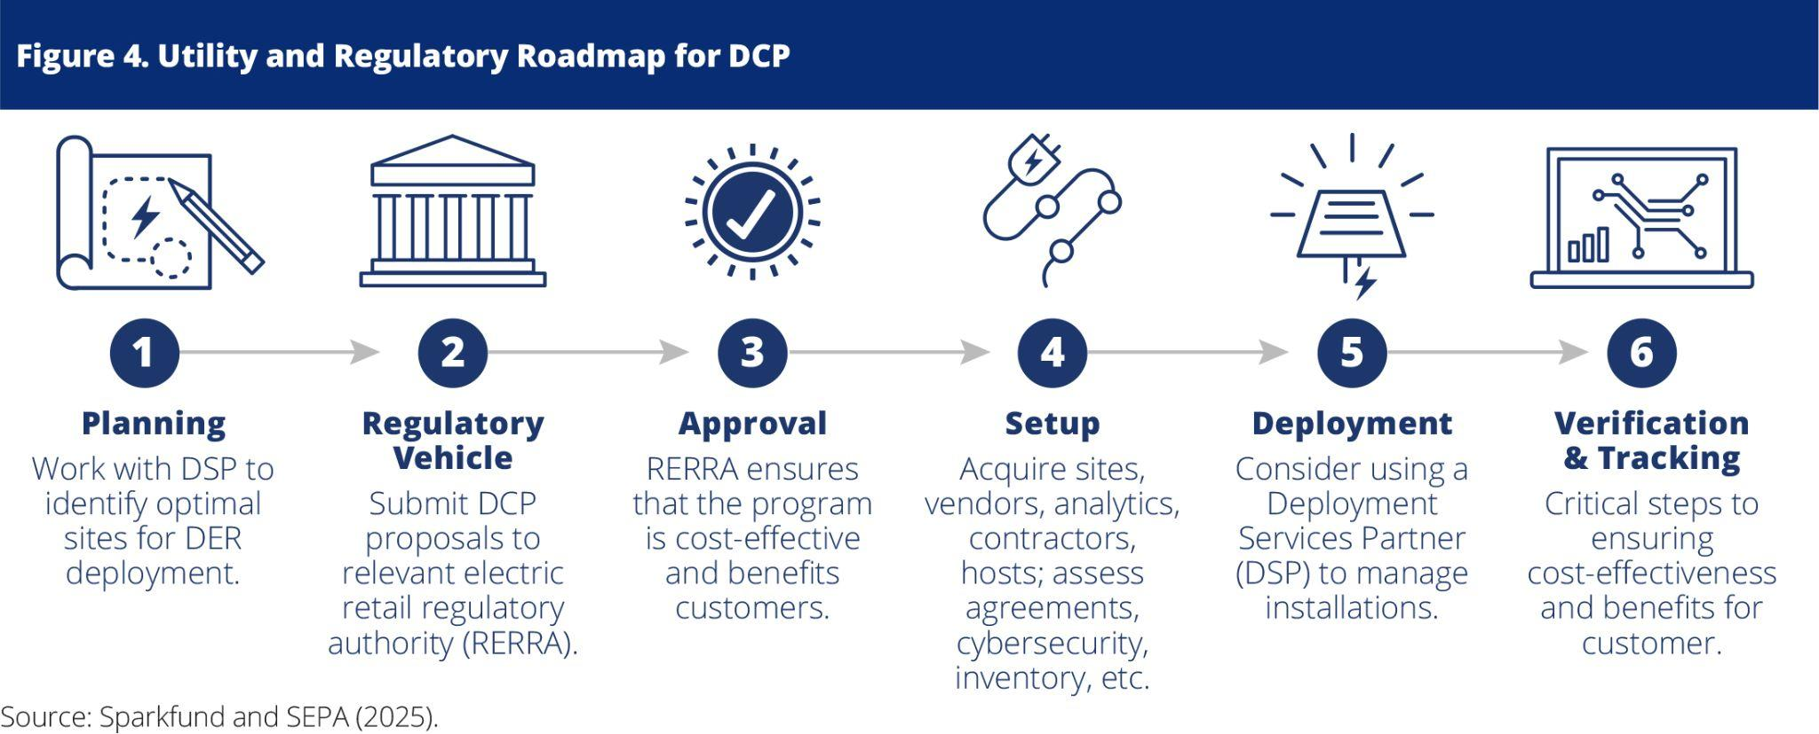
Regulatory Roadmap for DCP
Notes:
VPPs are also gaining regulatory momentum. In 2024, 105 state and investor-owned utility (IOU) regulatory actions supporting VPPs and distributed energy resources (DERs) were implemented across 37 states and Washington, D.C. These regulatory developments will accelerate deployment of flexible technologies, especially as nearly three-quarters (72%) of utility leaders report that regulatory compliance and mandates are the primary driver of innovation within their organizations.
Policy and regulatory momentum has continued apace in 2025, as the figure shows. Most notably, many of the states with the largest demand growth from data centers and industrialization, like Virginia, Georgia, and Louisiana have seen legislation, regulatory action, or new program filings.

Slide 7
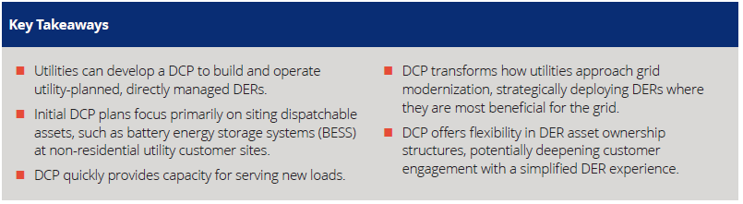
Key Takeaways

Slide 8
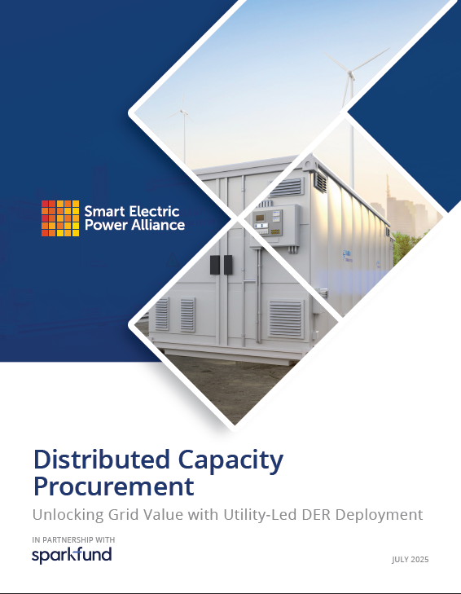

SEPA Resources: DCP White Paper
Notes:
Many utilities are planning for More VPP Capacity. In its Distribution System Plan, Portland General Electric, a vertically integrated IOU, signaled its intent to offset 25% of peak demand using its VPP by 2030.

