Slide 1

Resilient Microgrids for Rural and Tribal Communities Using AI and Distributed Battery Energy Storage
Michael Ryan, Kit Carson Electric Cooperative
September 10, 2025 , RE+ 2025, Las Vegas

Slide 2



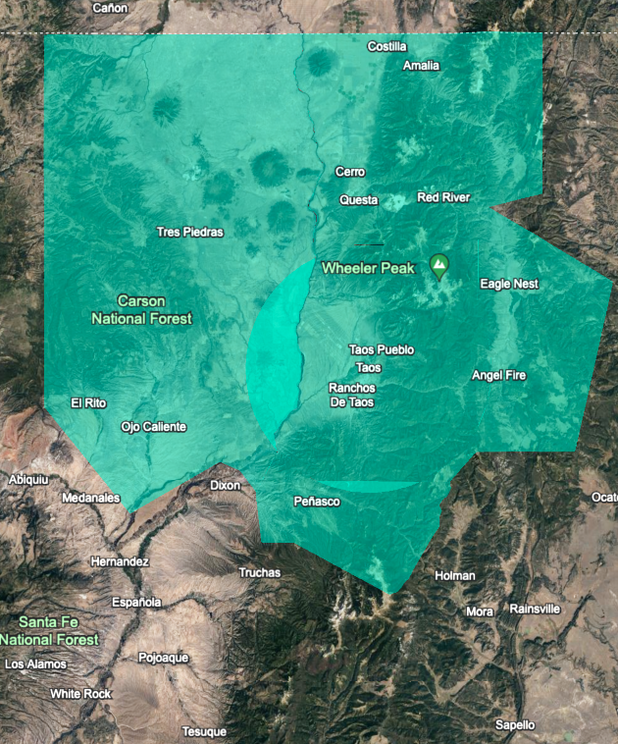
Kit Carson Electric Cooperative
42 MW+ | 16.25 MW+ | 36 | 65 MW
Solar Generation | Battery Generation | EV Charging Stations | System Peak (Nighttime Winter Peak)
KCEC at-a-glance
Electric Cooperative was founded in 1937 ( formerly Eagle Nest Electric Cooperative)
One of the most diverse and unique co-ops in the nation
Service area is 7,600 square miles in Taos, Colfax, and Río Arriba counties in northern New Mexico
Serving 30,720 Electric Members in NM (36,000 meters)
3,011 miles of electric line and 2,500 miles of fiber optic line
Second largest co-op in NM
100% Daytime Solar Distributed + 16.25 MW BESS

Slide 3
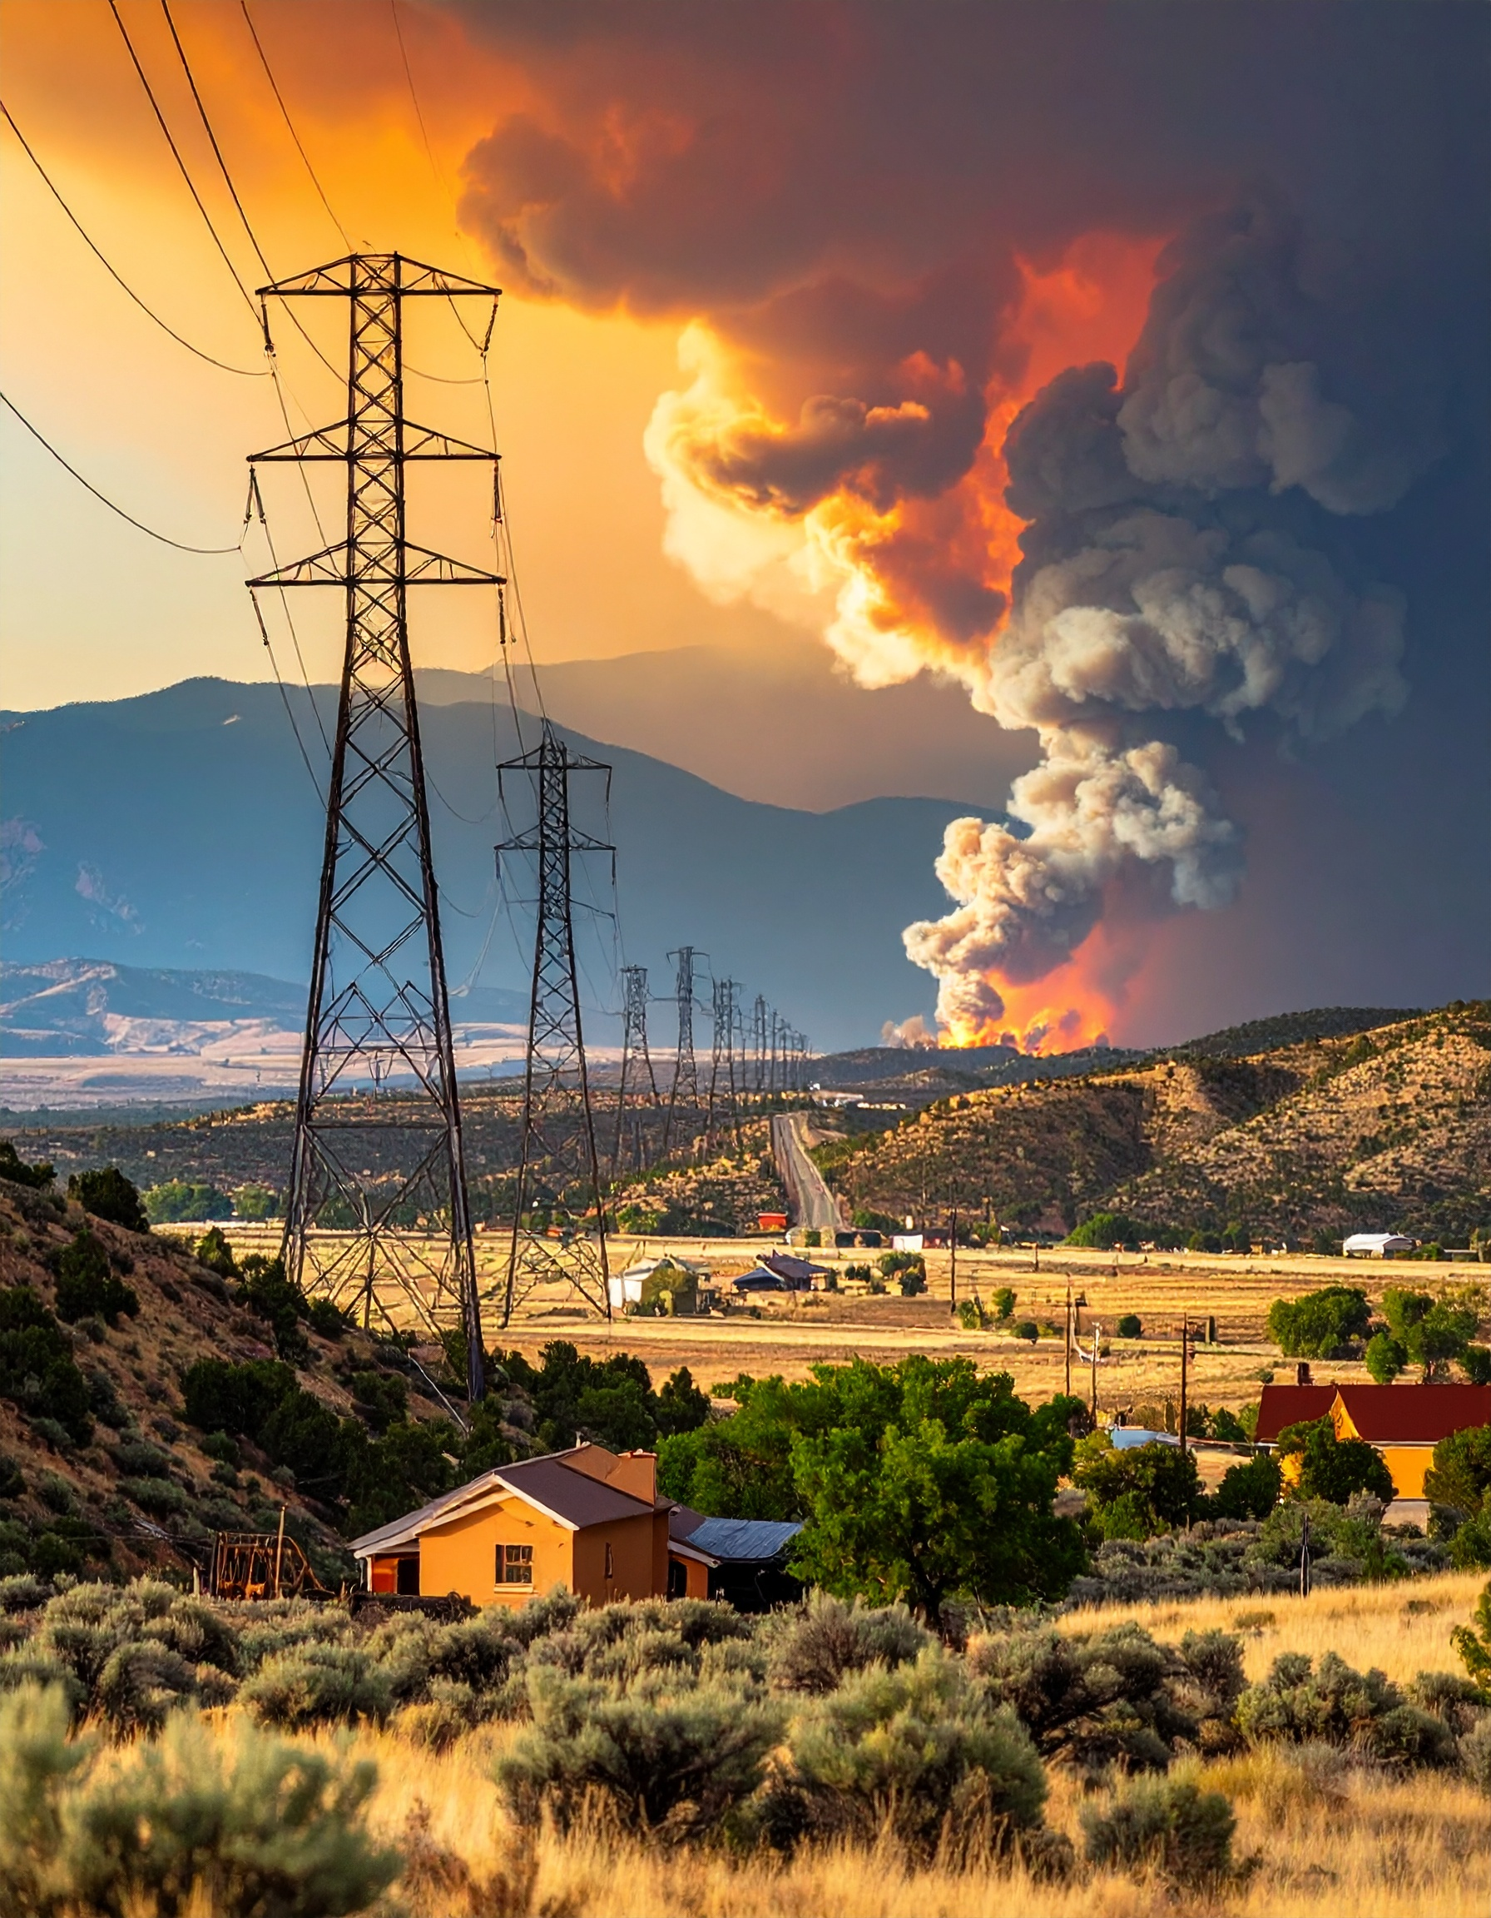
Why this Project
Critical need: resilience for essential services
ISSUE
Rural, tribal, and tourist areas → vulnerable to outages
Increasing wildfire, PSPS, and extreme weather risk
Critical need: resilience for essential service
IMPACT
Support members with medical needs and reduce mortality due to grid shutdown during extreme weather events to zero.
Provide our Pueblo, Rural, and Tourist communities with piece of mind during wind storms and fire.
Allow for individuals to evacuate from Taos Ski Resort safely during periods of natural disaster.
Integrate resilient energy workforce needs alongside local colleges and trade schools.

Slide 4

KCEC BESS/Microgrid Project
KCEC’s microgrid initiative is funded under DOE GRIP 40101(c).
It’s tailored for smaller utilities, co-ops, and rural/tribal regions. Explicitly designed for resilience, affordability, and equity in underserved communities.
4 year grant – BESS 2025-27, advanced microgrids 2027-28
Benefits of Project
Forest Fire Mitigation
Increase Reliability
Maintaining Critical Load Services
Back-Up Generation for Extreme Weather Events
Cybersecurity review and planning
Real-Time Monitoring and AI Evaluation
Electric Grid Islanding Capabilities
Notes:
On October 18, 2023, the U.S. Department of Energy selected Kit Carson Electric Cooperative (KCEC) to receive $23 million to enhance the U.S. power grid's ability to deliver affordable, clean energy to American communities across northern New Mexico. The funds will advance the Building a Modern, Intelligent Distributed Battery Energy Storage Systems (BESS) for Resiliency in Northern New Mexico project to mitigate the impacts of extreme weather and strengthen grid reliability.
Due to the rural, geographically and demographically diverse nature of its service territory, KCEC is especially vulnerable to impacts of power outages across the region from the threat of wildfire, extreme drought, and high wind events. KCEC will deploy BESS and microgrid capabilities to three locations. This will allow KCEC to perform public safety power shutoffs while maintaining critical loads and services locally island during an unplanned utility outage. The three locations identified are:
📌 What GRIP DOE Is
Full Name: Grid Resilience and Innovation Partnerships Program
Agency: U.S. Department of Energy (DOE), Office of Clean Energy Demonstrations (OCED)
Funding: About $10.5 billion total (2022–2026)
Purpose: To modernize and harden the electric grid against:
Extreme weather
Wildfires
Cybersecurity threats
Increasing renewable integration
📊 GRIP Program Structure
Grid Resilience Utility and Industry Grants (40101(c))
For utilities, tribes, co-ops, municipalities, and states
Focus: hardening grid assets and reducing outage risks
Smart Grid Grants (40107)
Supports deployment of smart grid technologies
Examples: distributed energy resource (DER) integration, EV charging, advanced sensors, AI grid optimization
Grid Innovation Program (40103(b))
Large regional transmission and distribution projects
Public-private partnerships for transformational grid investments
🔑 Why It Matters for KCEC
KCEC’s microgrid initiative is funded under GRIP 40101(c).
It’s tailored for smaller utilities, co-ops, and rural/tribal regions.
Helps cover 30–70% of project costs, depending on applicant size and type.
Explicitly designed for resilience, affordability, and equity in underserved communities.

Slide 5
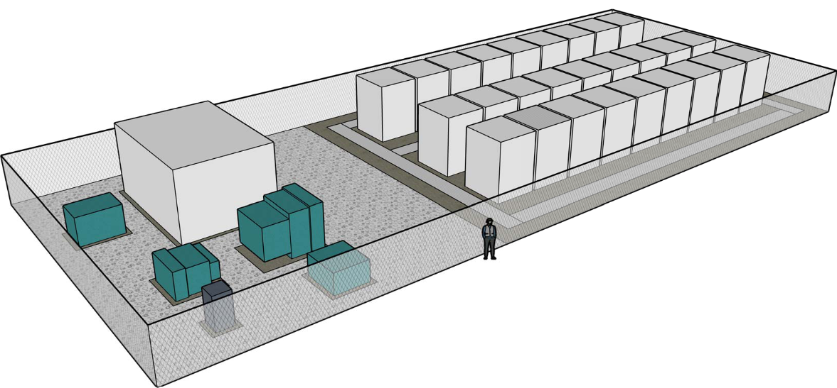
PowerSecure is our EPC Partner
BESS and Microgrid Controls
  Kore LFP DC Block
    750 kWh of storage capacity
    480VAC 3PH output
Three Sites
    El Rito 1.25 MW / 6.75 MWh
    Peñasco 2.50 MW / 13.5 MWh
    Taos Ski Valley 3.75 MW / 18 MWh
    TOTAL 7.50 MW / 38.25 MWh
  BABAA Compliant Components
    100% structural steel (rebar, skids)
    100% construction materials (pads, PVC, wire)
    >55% Manufactured Product
Notes:
Lithium Iron Phosphate (LFP)
Pros
High Safety: They are considered significantly safer than most lithium-ion batteries due to a lower risk of thermal runaway, making them less prone to fires in extreme conditions.
Long Cycle Life: They can withstand many more charge cycles than standard lithium-ion batteries, resulting in a longer lifespan.
Good Thermal Stability: Performs well in high-temperature environments with minimal degradation.
Environmentally Friendly: Contains no cobalt or nickel, considered environmentally problematic in lithium-ion batteries.
Lower Cost: Generally cheaper to produce than some lithium-ion battery types.
Cons
Lower Energy Density: Stores less energy per unit volume than other lithium-ion batteries, leading to heavier and bulkier battery packs.
Lower Power Density: They may not deliver high power bursts as effectively as other lithium-ion batteries.
Potential for Higher Initial Cost: While cost-effective in the long run due to their longevity, initial purchase price can be slightly higher depending on the application.
Limited Applicability: Not suitable for applications where weight and size are critical factors, like small portable electronics.
Lower Cost: Generally cheaper to produce than some lithium-ion battery types.

Slide 6
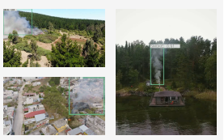
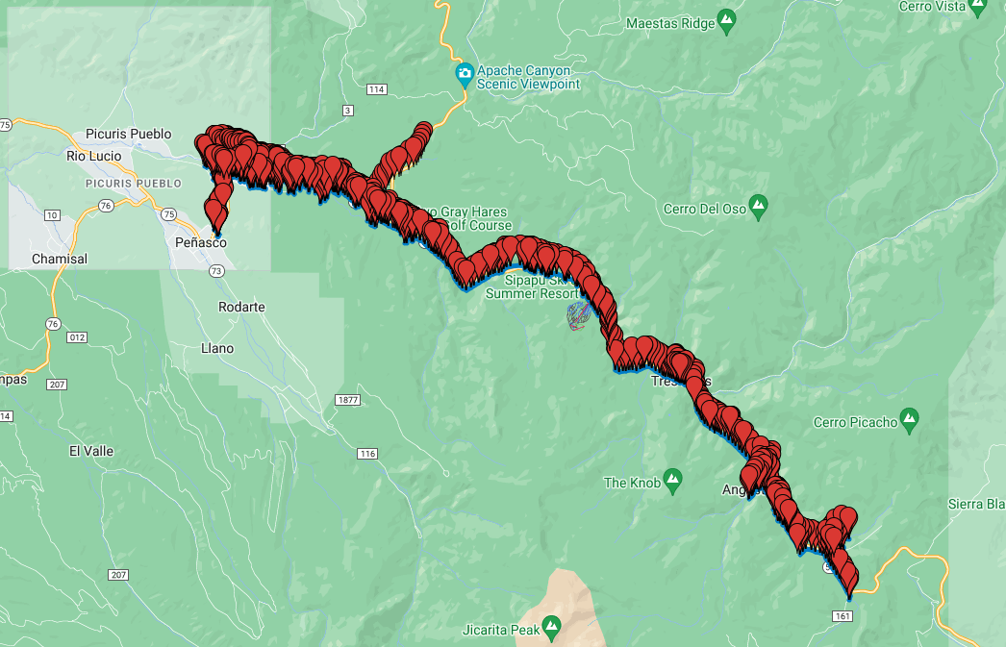
NMSU Smoke and Fire AI
Integrated Project and Safety Management Approach
AI + Edge Computing: Deploying IoT devices with integrated cameras, computation and advanced AI to detect wildfire smoke and obstructions in real time, day and night.
Integration with KCEC Infrastructure: Ensuring compatibility with existing utility poles, SCADA systems, and communications.
Field Pilot + Training: Installing devices in forested terrain, providing hands-on training to KCEC staff, and co-authoring technical papers.
Workforce Development: Offering educational opportunities on AI, microgrids, and resilience, including lectures and collaborative workshops with NMSU faculty.
New Mexico Technology: Partner with and integrate additional New Mexico based technologies such as IOT for moisture sensors, and software ignition prediction, fire propagation, and PSPS recommendations.

Slide 7
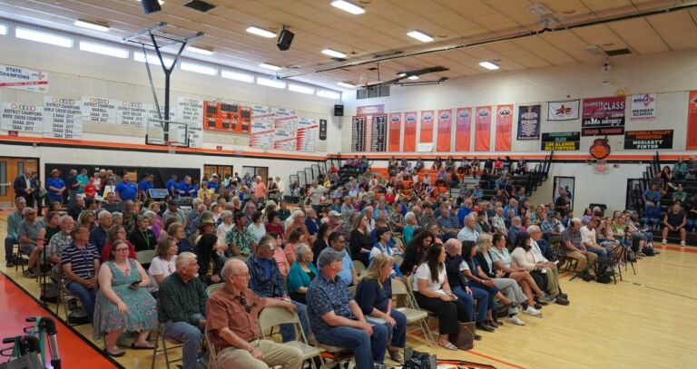
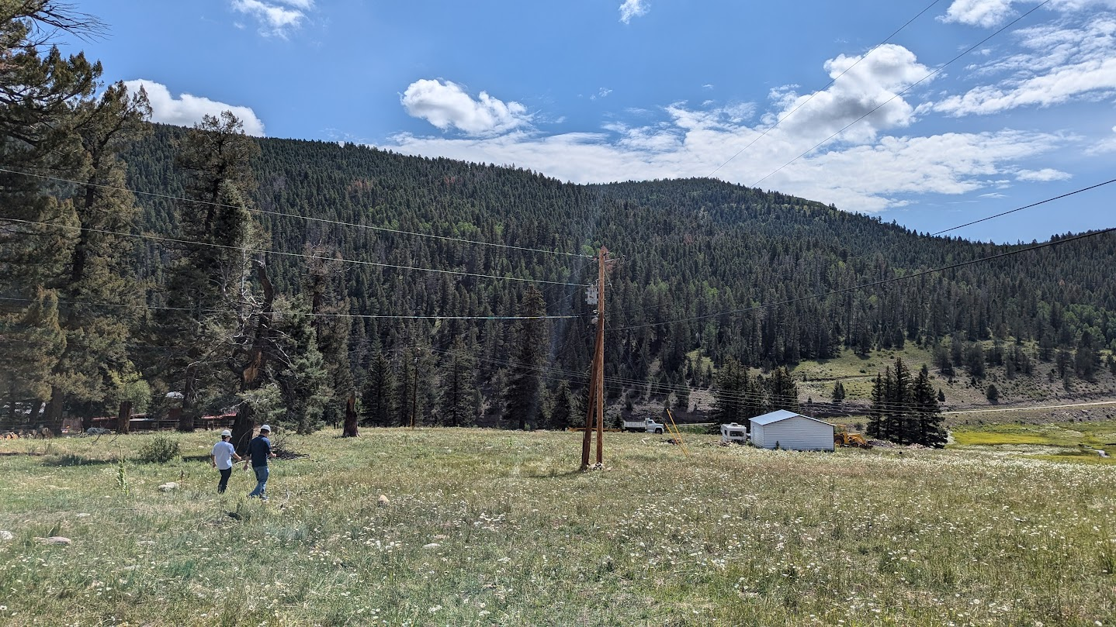
Key Challenges & Lessons Learned
Engagement is Key
BESS, Microgrids, Fire Tech – there is a lot to learn
DOE Federal Requirements and Timing
Supply Chain
Community Engagement & Shared Ownership
Leveraging Local Assets & Environmental Stewardship
Partnering for success with Site Owners, Consultants, OEMs, NM, Legislators, Labs, Universities
Job Creation & Economic Revitalization

Slide 8
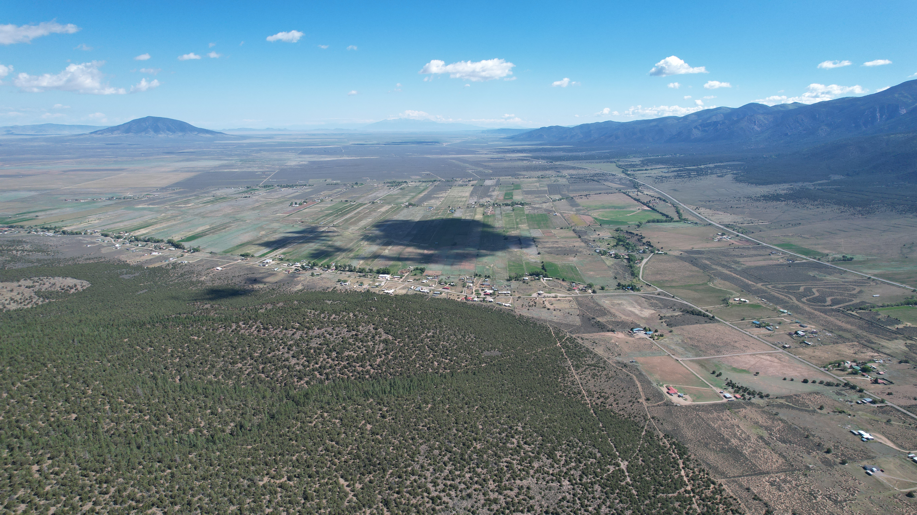
Closing/Call to Action

