Slide 1

Promoting care and compassion for frontline healthcare staff (through trauma-informed thinking)
Patient Safety Congress Conference: 15-16 September 2025
Dr Janet Balabanovic, Consultant Counselling Psychologist & Critical Care Psychology Lead at University College Hospital

Slide 2
Critical Care Psychology Aim
To support the critical care team to be trauma-informed in everyday care to improve outcomes
Target
Core activities
Staff
MDT /case conferences / internal liaison (e.g. MHLT, Safeguarding, Homeless Team, Addiction Team, etc)
Patients with complex medical, psychological and social needs
Case
Mgmt.
Cons/matron-led. MDT. Multi-agency
Patients or family members with potential mental health issues or expressing high levels of distress
Specialist assessment, formulation & brief intervention informed by evidence (not therapy). Transdiagnostic. Systemic.
Clinical/counselling psychology team in liaison with internal & external teams
Patients & families expressing understandable distress/ feelings of isolation etc.
Person centred, supportive discussions. Deliver simple psychological interventions and tailored self-help resources.
CNS, Volunteers, PCC/TIC Champs (supported by psychology)
Everyone (Prevention)
Creating a welcoming, trauma-informed and psychologically safe environment.
Good communications and active listening. Kindness and compassion. Dissemination of useful informational resources to all patients & family members
All staff

Slide 3
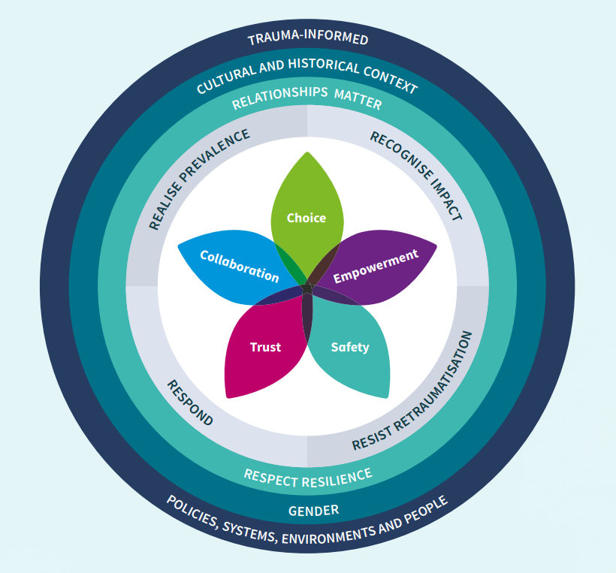
What does the being trauma-informed mean?
And why does it matter in physical health?
Trauma informed practice
(individual clinician-focus)
Trauma informed system
(organization & mgmt-focus)
Source: NHS Scotland Trauma Informed Practice Toolkit

Slide 4
TIP Training outcomes
A Trojan Horse for staff wellbeing and resilience training
“I always love the psychology sessions. It’s like seeing a therapist for work”
“I love how we get to chat about important things with colleagues
“Allows you to relax, reflect and make you conscious of your behaviour”
“Gives us understanding on how to deal with issues with patients and colleagues”
“Good for mental health & wellbeing”
“Learn how to deal with emotions”
“Very useful and practical to reflect what we are like in daily life at work.”
“It gave space to pause and reflect on our practice and how we can best support patients, their families and each other.”
“Helps you understand your pt/family's behaviour and how to de-escalate challenging situations”
“It helps us manage traumatic experiences looking after challenging patients and relatives.”
“Helps me understand the importance of reflection and of being in ‘the green zone’ myself”
”

Slide 5
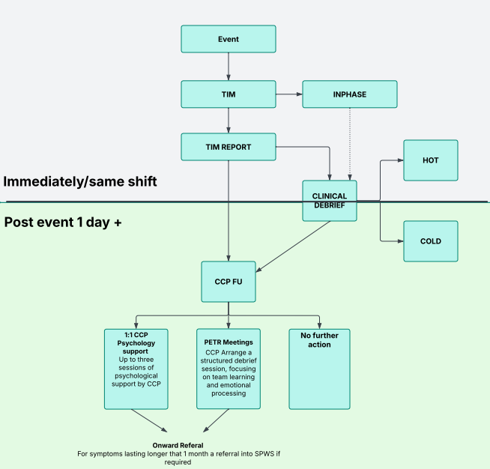
Establishing a staff safety pathway
Embedding trauma-informed thinking and interventions
The Team Immediate Meet (or TIM)
Post Event Team Reflection (PETR) Sessions

Slide 6
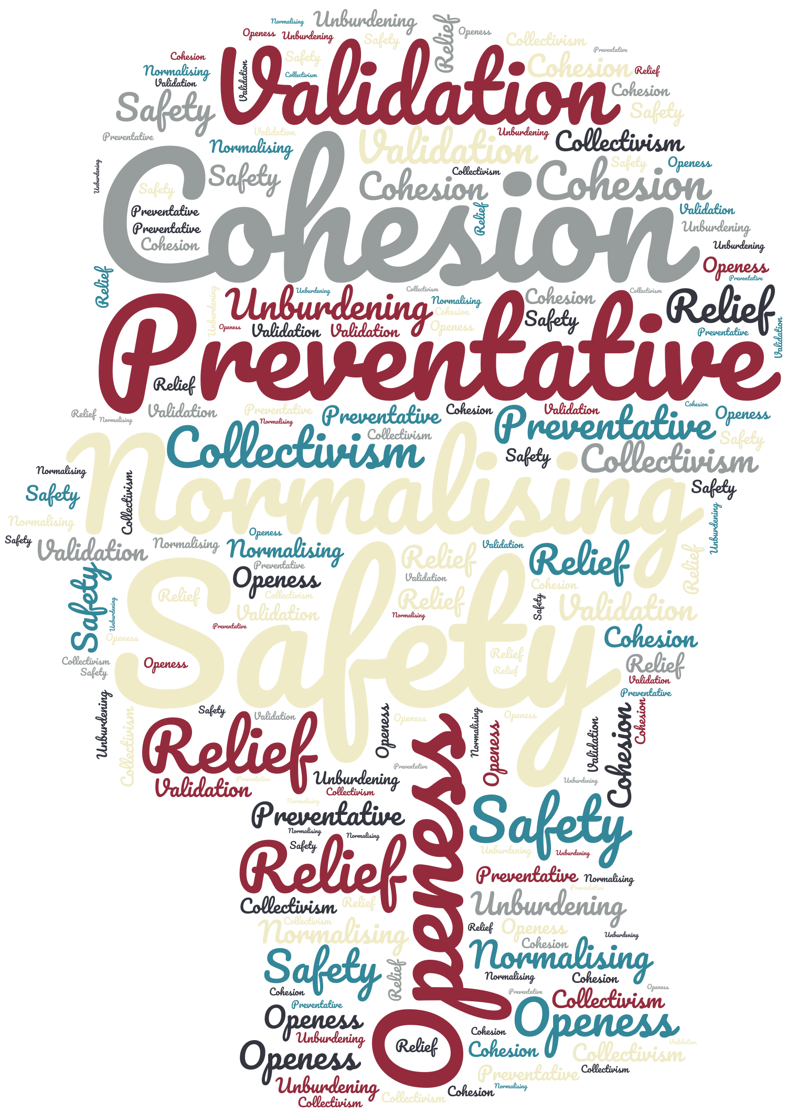
Team Immediate Meet staff feedback
(Intervention on the same day/shift)
"The TIM helped me to draw a line under my experience, so I didn't take it home with me”
Incident
Young female pt in ICU with T2 resp failure (Rare appendix cancer)
Unexpected rapid deterioration and death
Patient was Mandarin speaking
Family all present at the time of her death & very distressed
Not accepting of her medical status
Passed in half an hour leaving everyone in shock
"The TIM was so quick and easy to do... I didn’t have to worry as I knew staff would now get support"
"As a TIM leader I was able to set aside my own emotions when organising the TIM but I led by example and shared my own emotional response during the TIM"
"The structure of the TIM gave me the freedom to talk about my emotional experience"
"I found it really helpful to come together and check in on each other and hear other’s perspectives"
"Attending a TIM provided me with the confidence to instigate and lead a TIM."
"A hot debrief isn't helpful when people are feeling emotional; a TIM check-in means people can be followed up later which is better"
"This is SO needed I wish it had been available before now."

Slide 7
Post Event Team Reflection staff feedback Intervention 2-3 weeks post event
“It was the first time I've been offered this type of session during my 6 years as a doctor and it was truly invaluable”
“Hearing other’s perspectives made me feel proud of how things were handled”
“It gave me closure and answered my outstanding questions”
“A very safe and respectful forum to listen and to share feelings and experiences.”
“I will encourage others to take part in these sessions.”
“Please continue to deliver these excellent groups”
“This PETR has changed my perception of talking about these experiences, it’s very helpful and worthwhile”
“I really valued feeling safe, supported, and heard, hearing other team members’ experiences and having our responses to a traumatic experience normalised”
“The discussion led me to better understand what I felt less equipped to handle when a patient died”
“It was very helpful to understand others’ experiences and perspectives”
“I would recommend this session to everyone who experience a traumatic or challenging experience at work”

Slide 8

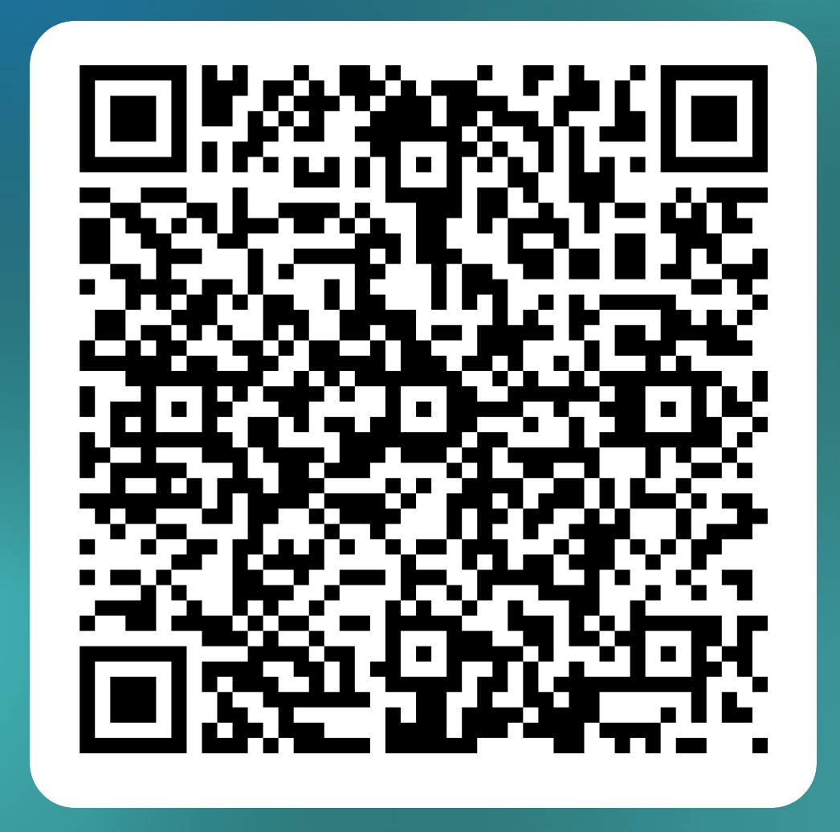
Please get in touch if you’d like to know more
Dr Janet Balabanovic
Critical Care Psychology Lead
Consultant Counselling Psychologist
BABCP Accredited Cognitive Behavioural Therapist
email: j.balabanovic@nhs.net
Mobile: 07974 630586

