Slide 1
Filip Filipov
19th February, 2025

Slide 2
There’s a fine line between vision and hallucination.
~ generated by AI
2

Slide 3
Technology: Cambrian Moment
We are here!
Slow start
Acceleration
1990s – 2000s
2000s – 2010s
2010s – 2020s
2010s – 2020
2020 – present
Internet
Social
Mobile
Cloud
AI
enablers
enablers
Infra
Protocols
PC
Networking
Web 2.0
Internet speed
Smartphones
Network effects
3-5G
App ecosystems
Processors
Touch screens
Data centers
SaaS models
Stateless tech
Fiber +
Data
GPUs
Learning models
Algorithms
Source: OAG Analysis
3

Slide 4



Generative AI
20 TB of data
> library of congress, 24m books
12,000 GPUs
> $300m + $4m a day
140GB
> Gpt 4o 222bn parameters
4

Slide 5
Large Language Model
140GB
Text here
500 lines of C code
Text here
5

Slide 6
Weaknesses
Data Analysis
Domain agnostic
Language understanding
6

Slide 7
Strengths
Hallucination
Resource Intensity
Ethical and Privacy Challenges
7

Slide 8
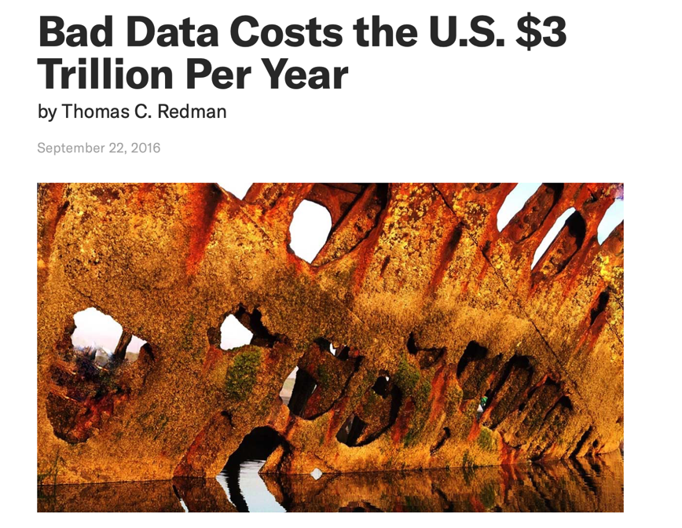
And this is 2016 estimates.
8

Slide 9
Dominant use cases
* Menlo VC
9

Slide 10






Names we should all remember
10

Slide 11
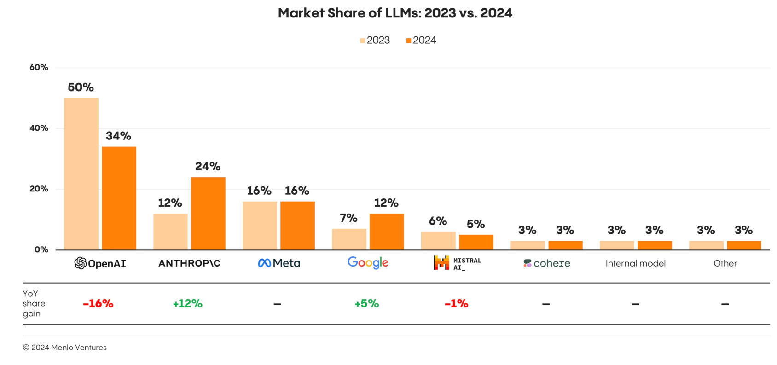
LLM Market Share
* Menlo VC
11

Slide 12
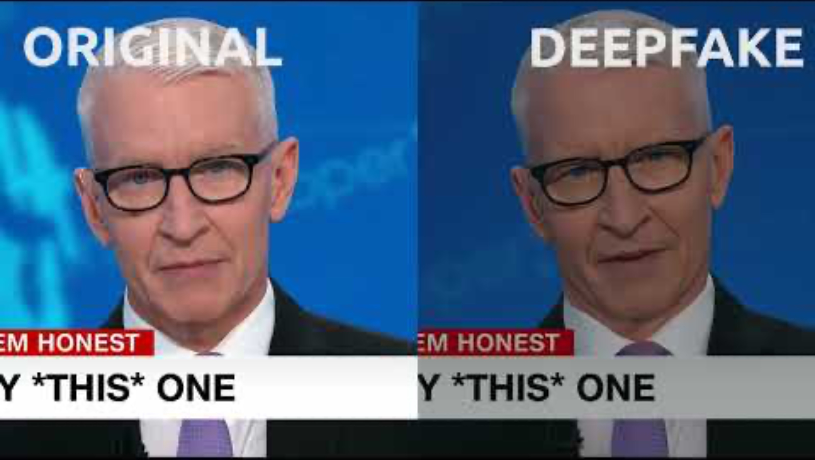
Ethical Considerations
12

Slide 13
What about Generative
AI and Travel?
13

Slide 14

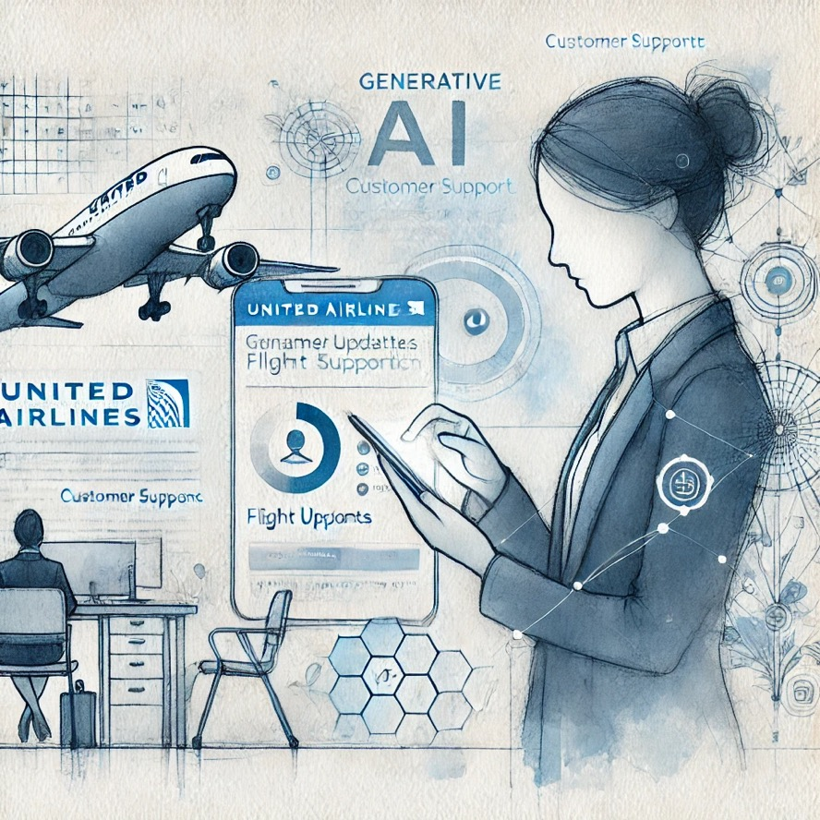
How can I help?
+6% Customer Satisfaction
Source: https://simpleflying.com/united-airlines-generative-ai-improvement-customer-satisfaction/?utm_source=chatgpt.com

Slide 15
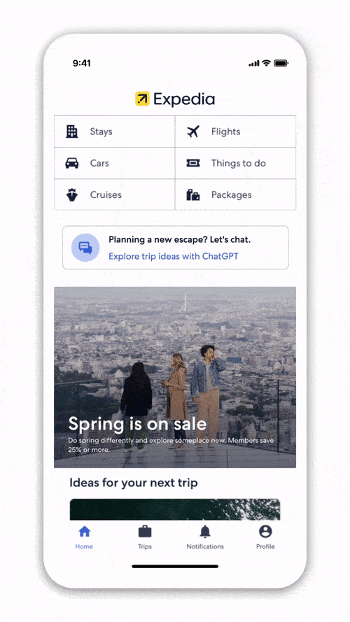

Dream it, plan it
29m virtual conversations
Source: https://www.expedia.com/newsroom/expedia-launched-chatgpt/

Slide 16
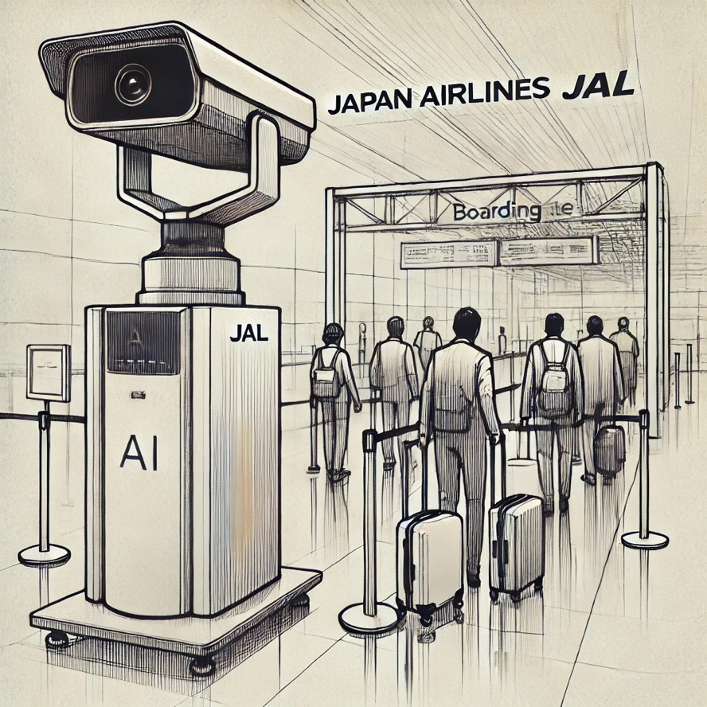

If it fits, it flies.
Pilot incredibly successful.
Source: https://press.jal.co.jp/en/release/202411/008488.html

Slide 17
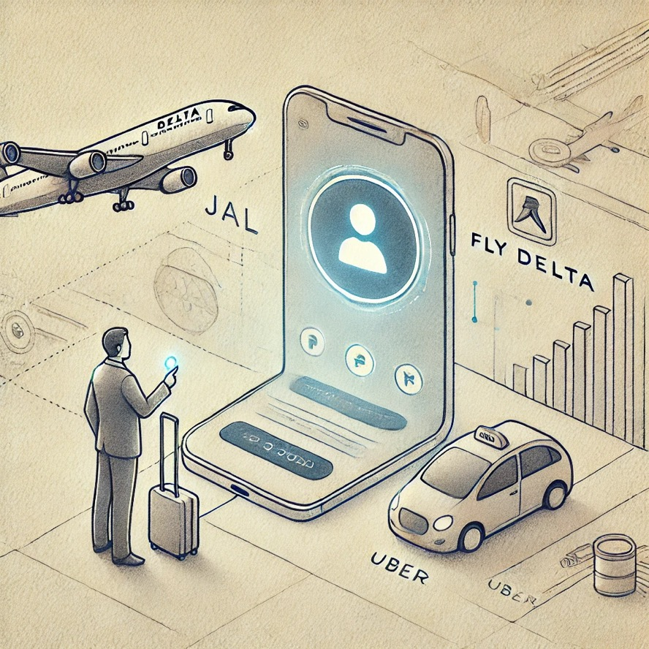

Concierge.
Yet to be released.
Source: https://www.futuretravelexperience.com/2025/01/delta-unveils-ai-powered-travel-journey-with-new-multi-modal-options-and-increased-personalisation/

Slide 18
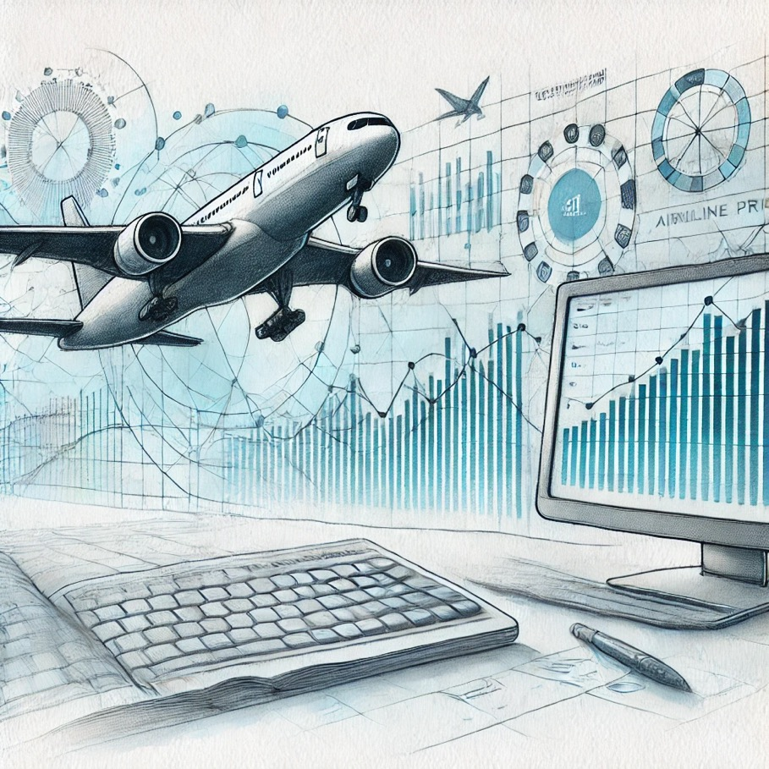

The price is right.
Yet to be released.
Source: https://www.aerotime.aero/articles/how-fetcherr-uses-generative-ai-to-drive-hyper-efficient-airline-pricing

Slide 19
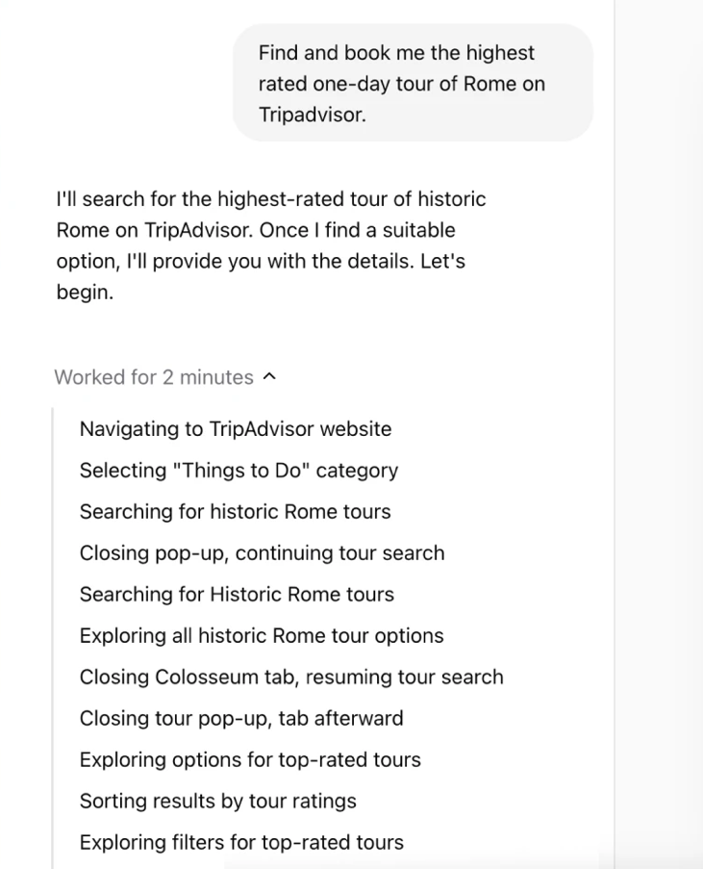
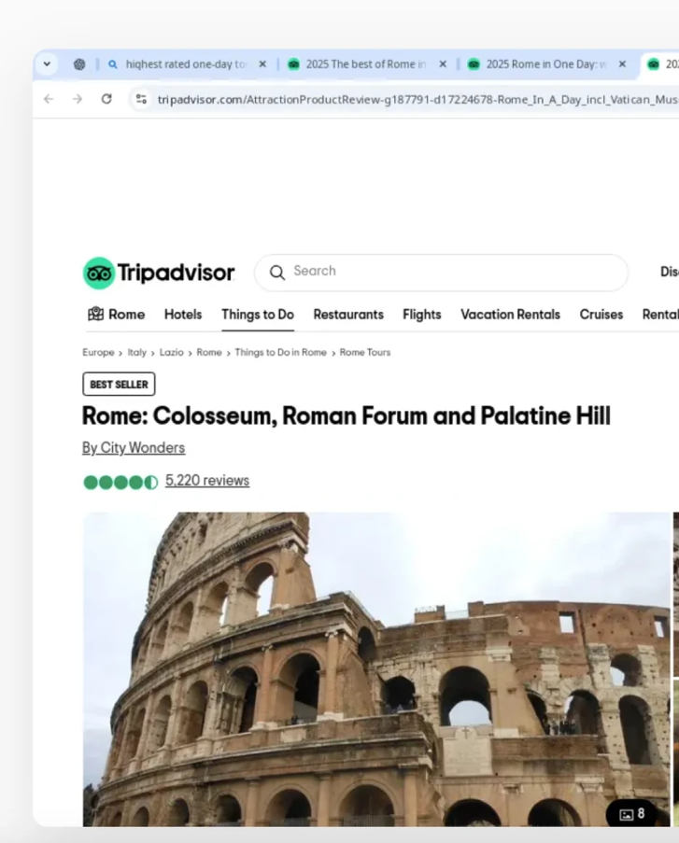
Winter is coming.
US Pro only.
Source: https://openai.com/index/introducing-operator/?utm_source=chatgpt.com

Slide 20
So what?
20

Slide 21
1. AI is here to stay.
21

Slide 22
2. Let’s go back to basics.
22

Slide 23
3. Best data wins.
23

Slide 24

Filip Filipov in/ffilipov
Let’s build the future of travel together.
19th February, 2025

