Slide 1
From refueling to multi-fuel stations: Construction and safety requirements
EIA25EV3114700
RE+
Las Vegas
Eduardo Galera
Michael Slowinske
Sept. 11, 2025

Slide 2



Who we are
EIA25EV3114700
Eduardo Galera
Eduardo is a global senior product manager with an electronics engineering background and a Master of Business Administration (MBA) in project management. He has more than 21 years of experience in testing, inspection and certification (TIC) and explosive equipment, and he also holds ISO 9001 Lead Auditor and Green Belt certifications. He represents UL Solutions on the Brazilian National Committee for IECEx and serves as program owner and assessor for this service. He is responsible for the Oil and Gas, Hydrogen, and Renewable Energy Product Management team, which includes the global portfolio as well as business development for new and innovative products.

Slide 3

Who we are
EIA25EV3114700
Michael Slowinske
As the senior director and regional general manager for the Americas, Mike works to identify safety risks in emerging technologies and drives standards development activity that supports safety science. He has a degree in environmental engineering from Washington University in St. Louis, and an MBA from Northwestern University’s Kellogg School of Management. He is a licensed professional engineer. Over his 28-year career, he has managed engineering operations and represented UL Solutions on the U.S. National Committee for IECEx and National Electrical Code® (NEC®) Code Making Panel (CMP) 1, as well as many National Fire Protection Association (NFPA), International Electrotechnical Commission (IEC) and other international standards committees and working groups. He has extensive experience in energy and explosion risk mitigation.

Slide 4
Agenda
EIA24EV1892465
Introduction
Refueling stations
Charging stations
Final considerations

Slide 5
EIA24EV1892465
As new technologies such as electric vehicles (EVs) and fuel cell electric vehicles (FCEVs) grow, there is a need to consider charging and hydrogen fueling in different locations to support the increase in demand.
Dedicated stations for EV and hydrogen may not necessarily be the answer; retrofitting refueling stations may be useful as existing infrastructure to support the installation of EV chargers and hydrogen dispensers. Installation codes and hazardous location requirements play an important role and require consideration when these new technologies are installed.

Slide 6
EV charger levels
EIA25EV3114700
Feature | Level 1 | Level 2 | Level 3 (DC fast)
Power source | 120 V AC (standard household outlet) | 240 V AC (residential/commercial) | 400-900 V DC (commercial/industrial)
Charging speed | 2-5 miles of range per hour | 10-60 miles of range per hour | 100-250+ miles of range per 30 minutes
Typical use case | Home charging overnight | Home, workplace, public stations | Highway corridors, fleet depots, fast stops
Installation cost | Minimal (uses existing outlet) | Moderate (requires dedicated circuit) | High (requires grid upgrade and equipment)
Connector type | SAE J1772 | SAE J1772 | Combined Charging System (CCS), CHAdeMO, Tesla Supercharger
Vehicle compatibility | All EVs (slow charge) | All EVs | Most EVs (depends on connector type)
Charging time (0%-80%) | 24-48 hours | 4-10 hours | 20-60 minutes
Infrastructure needs | None or basic outlet | Dedicated 240 V circuit | High-voltage supply, cooling, safety systems
Notes:
U.S. EPA – Plug-in Electric Vehicle Charging: The Details
U.S. Department of Energy – EV Charging at Home
Alternative Fuels Data Center – EV Charger Selection Guide (PDF)

Slide 7
Area classification per NFPA 70
EIA25EV3114700
Class | Division 1 | Division 2
Class I (flammable gases or vapors) | Ignitable concentrations of flammable gases or vapors exist under normal operating conditions or may exist frequently due to repair, maintenance or leakage. | Ignitable concentrations are not likely under normal conditions and only occur abnormally, such as during accidental rupture or system failure.
Class II (combustible dusts) | Combustible dust is present continuously, intermittently or periodically under normal operating conditions. | Combustible dust is not normally present, but may appear under abnormal conditions, such as equipment malfunction.
Class III (ignitable fibers or flyings) | Easily ignitable fibers or flyings are present during normal operations. | Ignitable fibers or flyings are stored or handled, but are not normally in the air during operations.
Additional notes:
Class defines the type of hazardous material (gas, dust or fibers).
Division defines the likelihood of the hazardous material being present in ignitable concentrations.
This classification system helps determine the appropriate electrical equipment and safety measures for hazardous locations.

Slide 8
Refueling stations
EIA25EV3114700

Slide 9
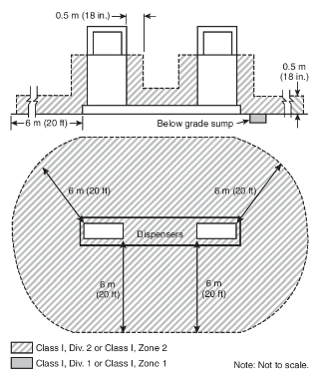
Flammable fuel dispenser area classification
EIA24EV1892465
625.17 (C), Overall cord and cable length
The overall usable length shall not exceed 7.5 m (25 ft) unless equipped with a cable management system that is part of the listed electric vehicle supply equipment.
Classified areas adjacent to dispensers
Source: Figure 514.3 of the NEC

Slide 10
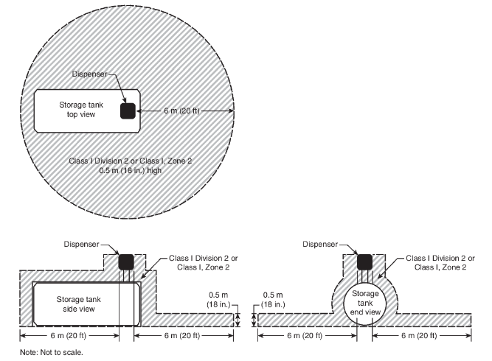
Flammable fuel storage area classification
EIA24EV1892465
Classified areas adjacent to dispenser mounted on aboveground storage tank
Source: Figure 514.3(B) of the NEC

Slide 11
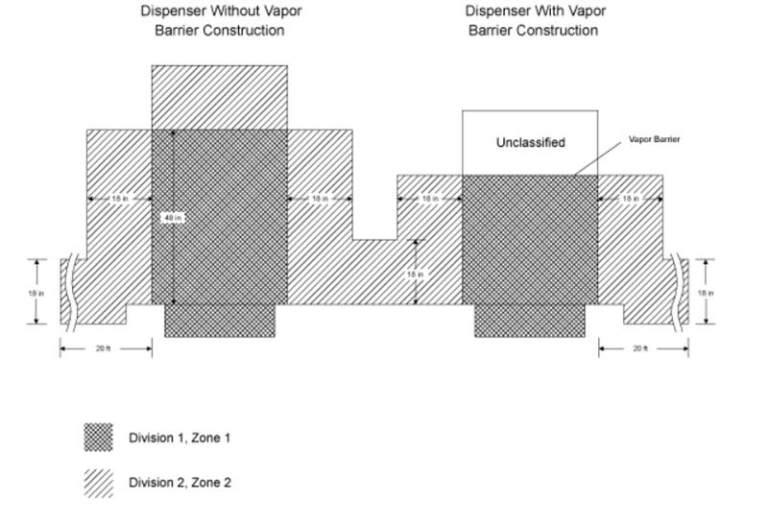
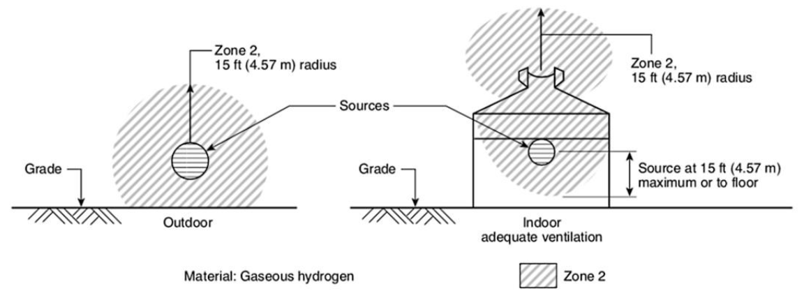
Gasoline and hydrogen dispenser area classification
EIA25EV3114700
Source: UL 87, the Standard for Power-Operated Dispensing Devices for Petroleum Products
Source: NFPA 497

Slide 12
Charging stations
EIA25EV3114700

Slide 13
Risks associated
EIA25EV3114700
Risk category | Description | Examples/impacts | Mitigation measures
Electrical hazards | High-voltage systems (up to 800 V) pose shock risks if improperly installed. | Exposed wires, faulty connectors | Use certified equipment, follow NEC and UL standards
Fire hazards | Lithium-ion batteries can ignite due to thermal runaway or overcharging. | Fires in parking garages, prolonged burn times, reignition risks | Fire-rated materials, spacing, suppression systems
Environmental hazards | Toxic fumes from battery fires, risk of soil/water contamination | Hazardous chemical release during fire | Ventilation systems, containment protocols
Infrastructure limits | Existing sites may lack power capacity, fire suppression or structural support. | Overloaded transformers, weakened concrete from heat | Site assessment, grid upgrades, structural reinforcements
User safety risks | Poor signage, unclear instructions or exposed components | User injury, misuse of equipment | Clear labeling, user education, emergency stop buttons
Placement and spacing | Inadequate spacing between chargers and vehicles increases fire spread risk | Multiple vehicles damaged in fire due to close proximity | Follow NFPA spacing guidelines, allow emergency access
Emergency access | Limited access for fire trucks or responders in enclosed or crowded areas | Delayed response, increased damage | Design with emergency routes and responder access in mind
Regulatory compliance | Failure to meet local codes and standards can lead to legal and safety issues. | Fines, shutdowns, liability in case of accidents | Adhere to NFPA, UL, Occupational Safety and Health Administration (OSHA) and local building codes
Cybersecurity risks | Vulnerabilities in networked chargers can be exploited for data theft or grid disruption. | Unauthorized access, malware injection, grid instability, user data breaches | Implement National Institute of Standards and Technology (NIST) Cybersecurity Framework, secure protocols, regular audits, firmware updates

Slide 14
EV chargers at refueling stations
EIA24EV1892465
Category | Considerations
Site assessment | Available space for chargers and vehicle parking Traffic flow and accessibility Visibility and signage
Power supply and infrastructure | Proximity to electrical panels or transformers Grid capacity and load balancing Potential need for upgrades, e.g., transformers, panels
Safety and compliance | Adherence to NEC and UL standards as well as local electrical codes Fire safety and emergency access Americans with Disabilities Act (ADA) accessibility compliance
Zoning and permitting | Local zoning laws for mixed-fuel stations Environmental impact assessments Permits for electrical and construction work
Integration with existing fuels | Safe separation from gasoline/diesel dispensers Fire-rated barriers and spacing Coordination with existing piping and conduit routes
Cybersecurity | Secure network protocols for smart chargers Protection against unauthorized access and data breaches Regular firmware updates and monitoring
User experience | Clear instructions and interface Payment system integration Lighting and weather protection
Scalability and future-proofing | Planning for future EV demand Modular infrastructure for adding more chargers Compatibility with multiple vehicle types
Environment and sustainability | Use of renewable energy sources if possible Energy-efficient equipment Waste and runoff management during installation

Slide 15
Multi-fuel considerations
EIA25EV3114700

Slide 16
Technological needs
EIA25EV3114700
Feature | Gasoline dispenser | Hydrogen dispenser | EV Charger Level 3 (DC fast charger)
Fuel type | Gasoline or diesel | Compressed hydrogen gas | Electricity (DC)
Energy transfer method | Liquid fuel pumped via hose | Gas dispensed under high pressure | Electrical current via connector
Typical refueling time | 3-5 minutes | 3-10 minutes | 20-60 minutes (varies by battery size and power)
Dispenser pressure | Low pressure (50 PSI) | High pressure (350-700 bar) (5,000-10,000 PSI) | -
Connector type | Nozzle (standardized) | Nozzle with secure locking mechanism | CCS, CHAdeMO, Tesla Supercharger
Infrastructure needs | Underground tanks, ventilation, fire safety | High-pressure tanks, cooling systems, safety, adequate space | High-voltage grid connection, cooling systems
Safety considerations | Flammable liquid, spill risk | Highly flammable gas, explosion risk | Electrical shock, thermal management
Environmental impact | CO₂ emissions, air pollution | Zero tailpipe emissions, but energy-intensive | Zero tailpipe emissions, depends on grid source
Cost of installation | Moderate | High | High
Use case | Widely used for internal combustion engine vehicles | Used for hydrogen FCEVs | Used for battery electric vehicles

Slide 17
Multi-fuel station
EIA24EV1892465
Power to the site
Zoning and regulatory requirements
Site factors and space allocation
Relationship to liquid fueling infrastructure
EV charger approach
Utility accommodation
EV charging infrastructure
Power backup needed
Type and number of EV chargers needed
Site’s traffic pattern
Positioned near transformers and/or incoming power
Other fueling options such as H₂, liquefied natural gas (LNG), etc.
Physical protections
Federal, state and local permits
Distance between EV chargers and fuel dispensers
Hazardous location requirements
Signage
Optimal ratio of EV charging stations to liquid fueling positions
EV charger blocking liquid fueling
Fuel tanks and piping vs. power conduit
Fuel spill flow distance

Slide 18
Multi-fuel station
EIA25EV3114700
Category | EV charger (Level 3) | Hydrogen dispenser | Gasoline/diesel dispenser | Shared considerations
Power to site | High-voltage (400-900 V DC) Grid upgrade or battery-buffered systems Transformer and panel capacity | Compressors and cooling systems High-power electrical systems for gas compression | Standard electrical for pumps Emergency shutoff systems | Utility coordination Load balancing Backup power
Zoning and regulatory | NFPA 70, UL 2202*, ADA compliance Local permitting Fire code adherence | NFPA 2, HGV 4.1/4.9, HGV 4.3/SAE J2601 Hazardous area zoning Blast radius regulations | NFPA 30/30A, local fire codes Environmental permits | Multi-agency approvals Environmental impact assessments
Site factors and space | Dedicated parking Accessibility Cable routing and bollards | Safety zones Storage tanks Ventilation and fencing | Underground tanks Spill containment Traffic flow | Clear signage Emergency access Lighting and surveillance
Distance and separation | Minimum clearance from flammable sources EV supply equipment (EVSE) spacing standards | 5 m (16 ft) from source of release minimum spacing Separation from other fuels | 3-5 m (10-16 ft) from other dispensers Fire-rated barriers | Compliance with NFPA and local codes Layout optimization
Piping and conduit | Conduit for high-voltage cables Weatherproof enclosures | Stainless steel or composite piping Leak detection systems | Fuel-grade piping Vapor recovery systems | Underground routing Corrosion protection Maintenance access
Safety and monitoring | Ground fault protection Emergency stop User interface safety | Gas leak detection Overpressure protection Fire suppression | Spill sensors Overfill protection Fire extinguishers | Integrated monitoring systems Staff training Incident response plans
*UL 2202, the Standard for DC Charging Equipment for Electric Vehicles

Slide 19
Benefits and challenges
EIA25EV3114700
Aspect | EV charger (Level 3) | Hydrogen dispenser | Shared considerations
Infrastructure requirements | 1,000 A at 480/277 V, three-phase service 1,200-1,500 sq. ft. space Battery-buffered systems for limited grid capacity | High-pressure storage (350-700 bar) (5,000-10,000 PSI) Specialized piping and cooling Safety zones and blast protection | Zoning and permitting Fire safety systems Integration with existing fuel systems
Benefits | Attracts EV customers Supports sustainability goals Access to incentives and rebates | Enables FCEV refueling Positions station for future mobility trends | Diversified revenue streams Enhanced brand image
Challenges | High installation cost Utility upgrades Regulatory compliance Space constraints | Complex safety protocols High cost of equipment Limited FCEV adoption | Coordination with multiple authorities Staff training Insurance and liability
Key standards and guidelines | NFPA 70 (National Electrical Code) UL 2202, UL 2231* (EVSE safety) National EV Infrastructure (NEVI) Pump Energy Index (PEI)/North American Charging Standard (NACS)/Fuels Institute guidelines | NFPA 2 (Hydrogen Technologies Code) HGV 4.1/4.9 (hydrogen fueling dispensers and stations) HGV 4.3/SAE J2601 (fueling protocol) | OSHA, Environmental Protection Agency (EPA), code authorities Building codes, environmental impact assessments
*UL 2231, the Standard for Personnel Protection Systems for Electric Vehicle (EV) Supply Circuits

Slide 20
Codes and standards development
EIA24EV1892465
Fuel type | Relevant codes and standards | Standards | Focus areas
Gasoline/diesel | NFPA 30, Flammable and Combustible Liquids Code NFPA 30A, Code for Motor Fuel Dispensing Facilities and Repair Garages NFPA 70, National Electrical Code API RP 1637 for retail motor fuel dispensing UL 87 for power-operated dispensing devices UL 1238, Standard for Control Equipment for Use with Flammable Liquid and LP-Gas Dispensing Devices | NFPA, API, UL | Fire safety, spill containment, equipment standards
Hydrogen | NFPA 2, Hydrogen Technologies Code CAN/BNQ 1784-000, Canadian Hydrogen Installation Code SAE J2601 fueling protocols HGV 4.1, Hydrogen-Dispensing Systems HGV 4.9, Hydrogen Fueling Stations UL 2249, Outline of Investigation for Hydrogen Fuel Dispensing Systems | NFPA, CAN/BNQ, SAE, HGV, UL | Dispensing safety, pressure systems, leak detection
EV chargers | NFPA 70, National Electrical Code UL 2202 and UL 2231 for EVSE safety IEC 61851, Electric Vehicle Conductive Charging System NEC Article 625 | NFPA, UL, IEC, NEC | Electrical safety, installation, connector standards
Multi-fuel integration | International Building Code® International Code Council (ICC) guidelines for EV readiness Local zoning and permitting codes Regulations, codes, standards (RCS) for alternative fuels | ICC, local authorities, Department of Energy, PEI RP1800 | Site layout, zoning, accessibility, fire separation

Slide 21
EIA25EV3114700

Slide 22
EIA25EV3114700

Slide 23
EIA24EV1892465

