Slide 1
How can we effectively integrate cyber security strategies into their everyday decision-making processes?
Patrick MANA
EUROCONTROL

Slide 2
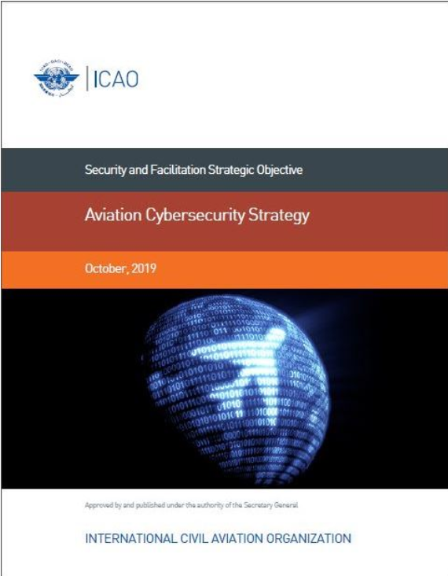
Do you have a cyber strategy?

Slide 3
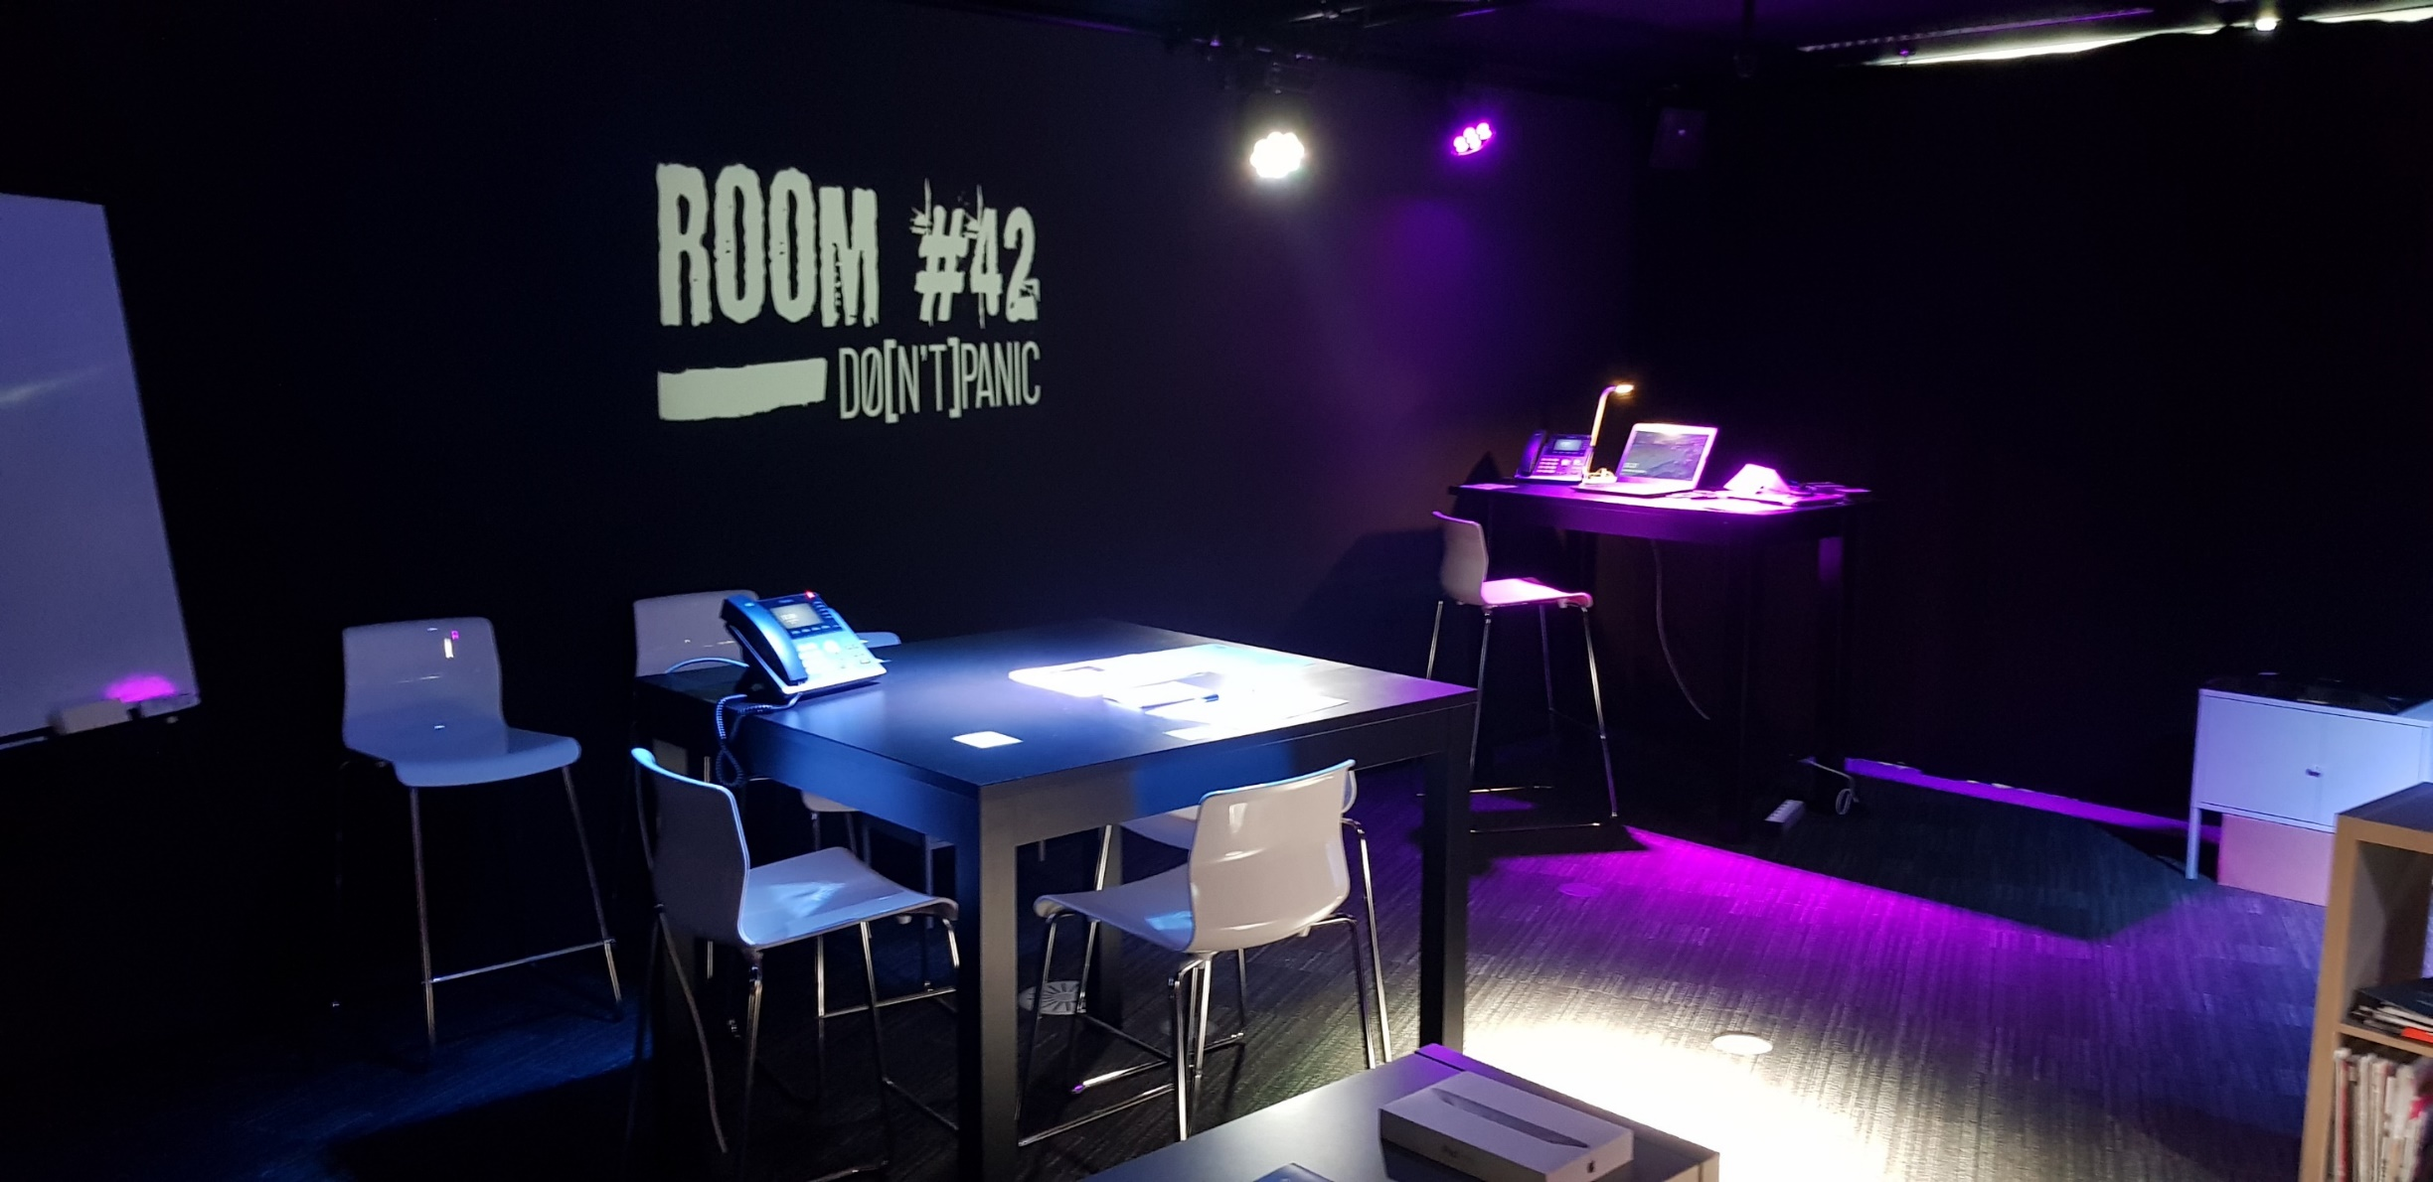
Are you ready to manage a cyber crisis?

Slide 4
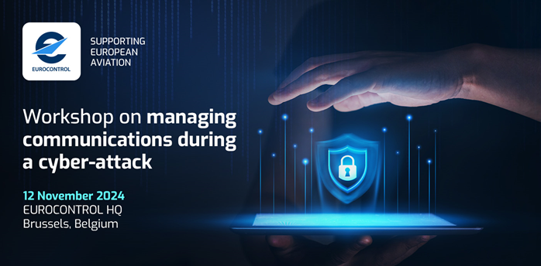
Do you know how to communicate at the time of a cyber crisis?

Slide 5
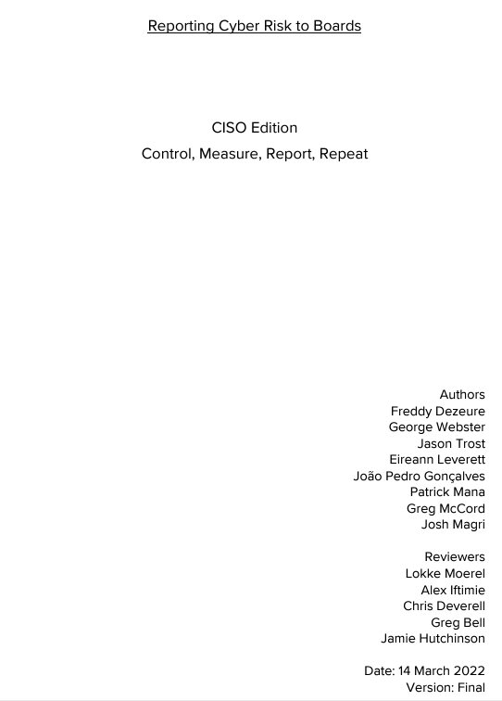
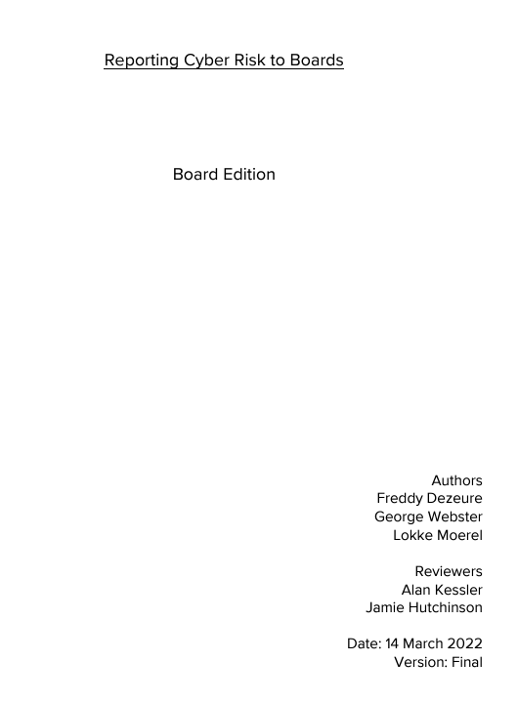
How do you report cyber to your senior management ? To your board?
https://www.eurocontrol.int/service/european-air-traffic-management-computer-emergency-response-team

Slide 6
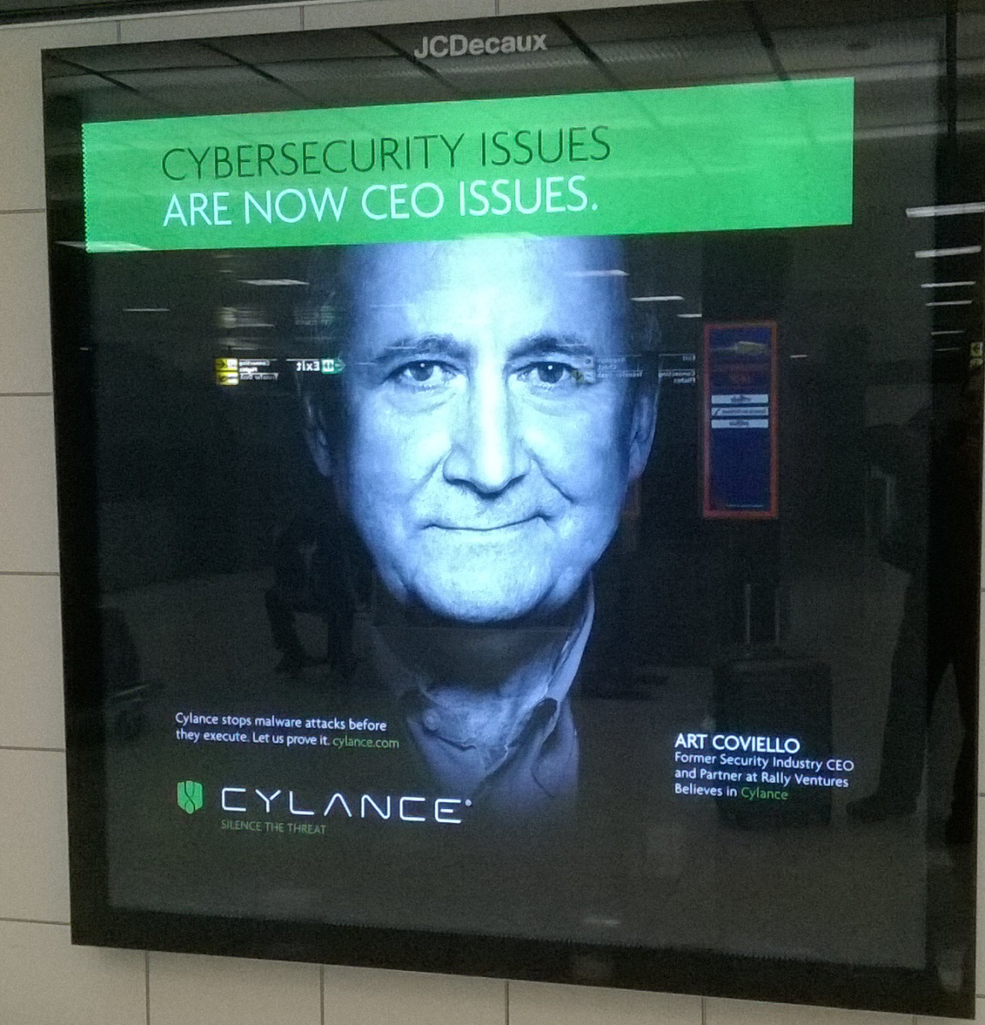

Why doing it ?
EC 2022/2555 (NIS 2)
EC 2023/203 (Part-IS)
…
&
You need it
It’s required

Slide 7
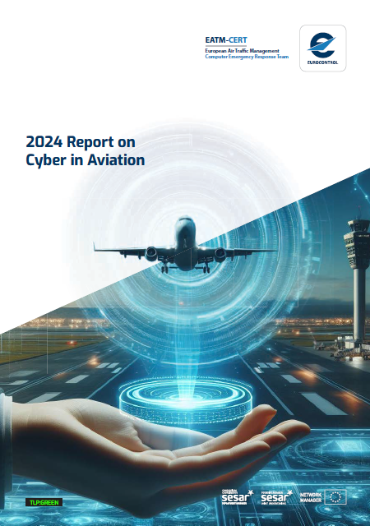
Pre-requisite Knowing the aviation cyber threat landscape
The report is
TLP:GREEN

Slide 8
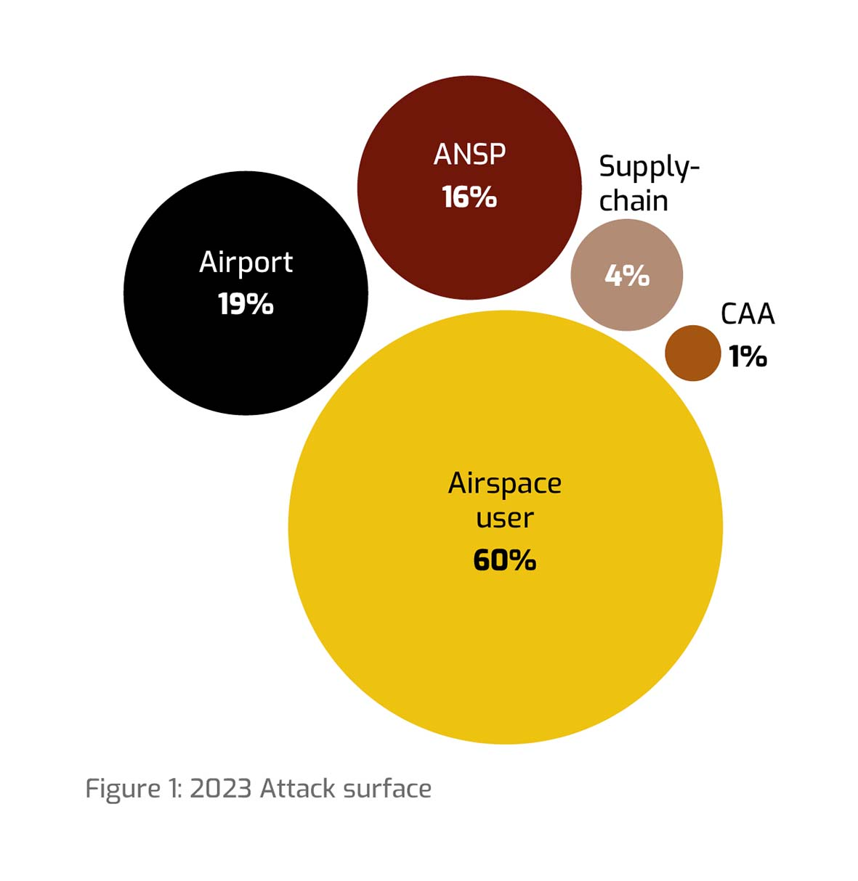
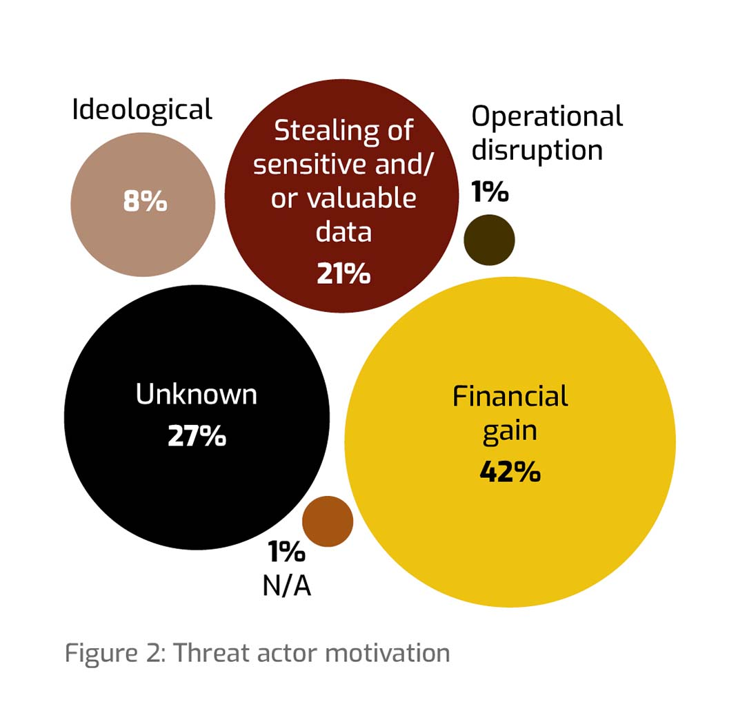
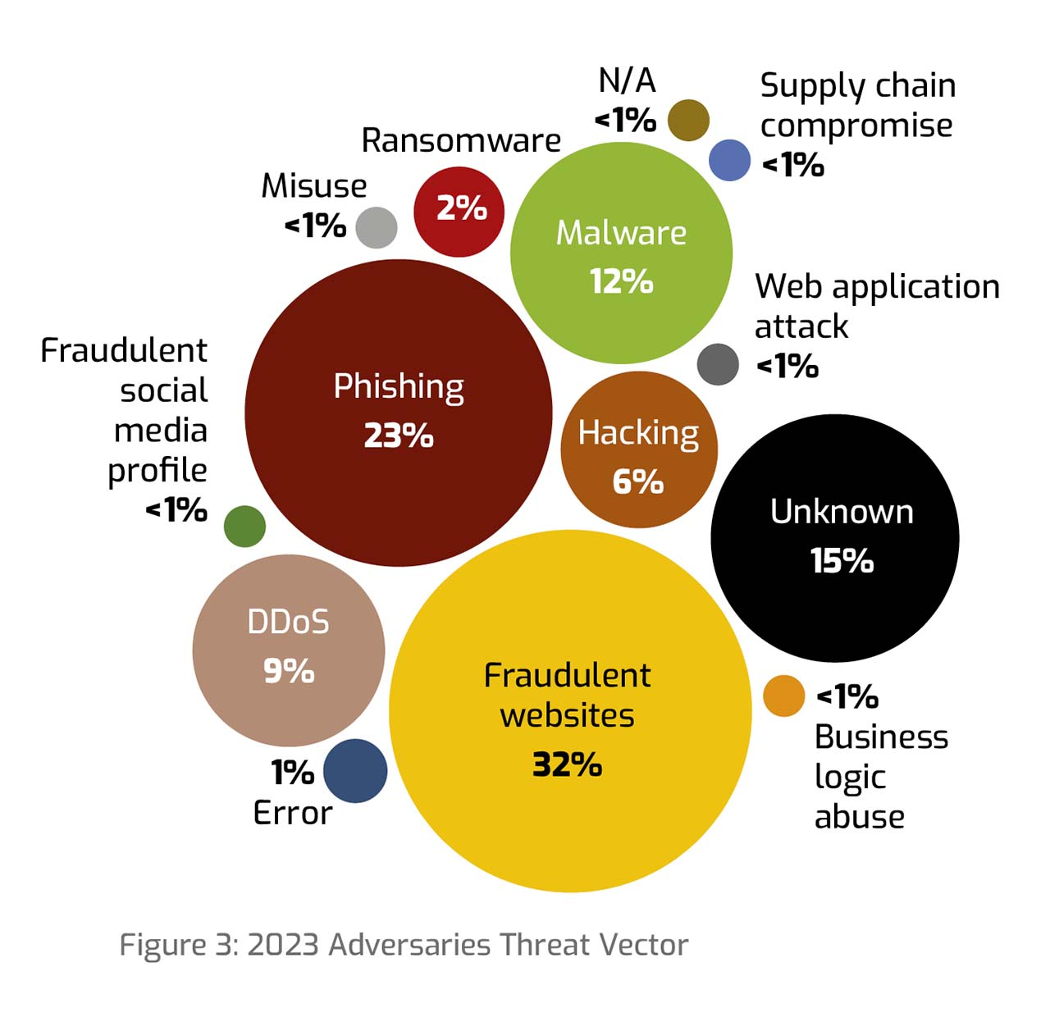
6.320 events – worldwide aviation
TLP:GREEN

Slide 9
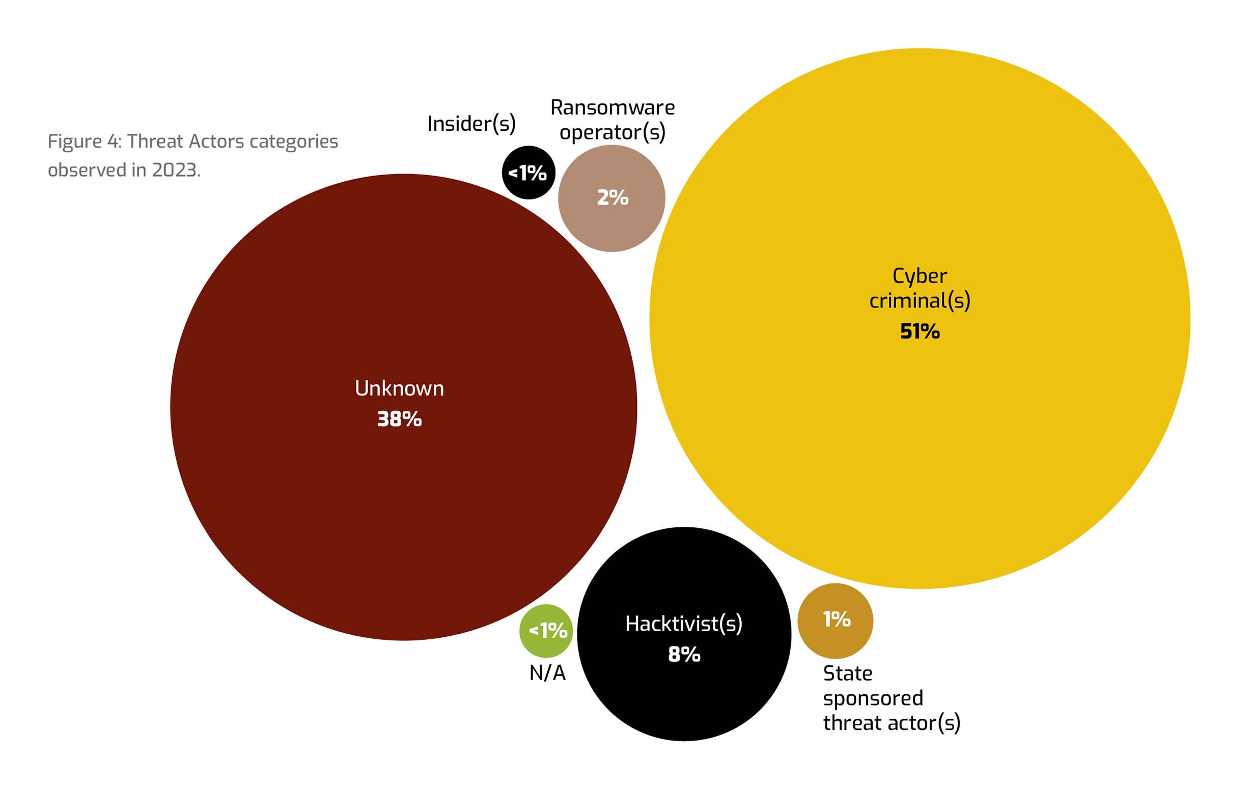
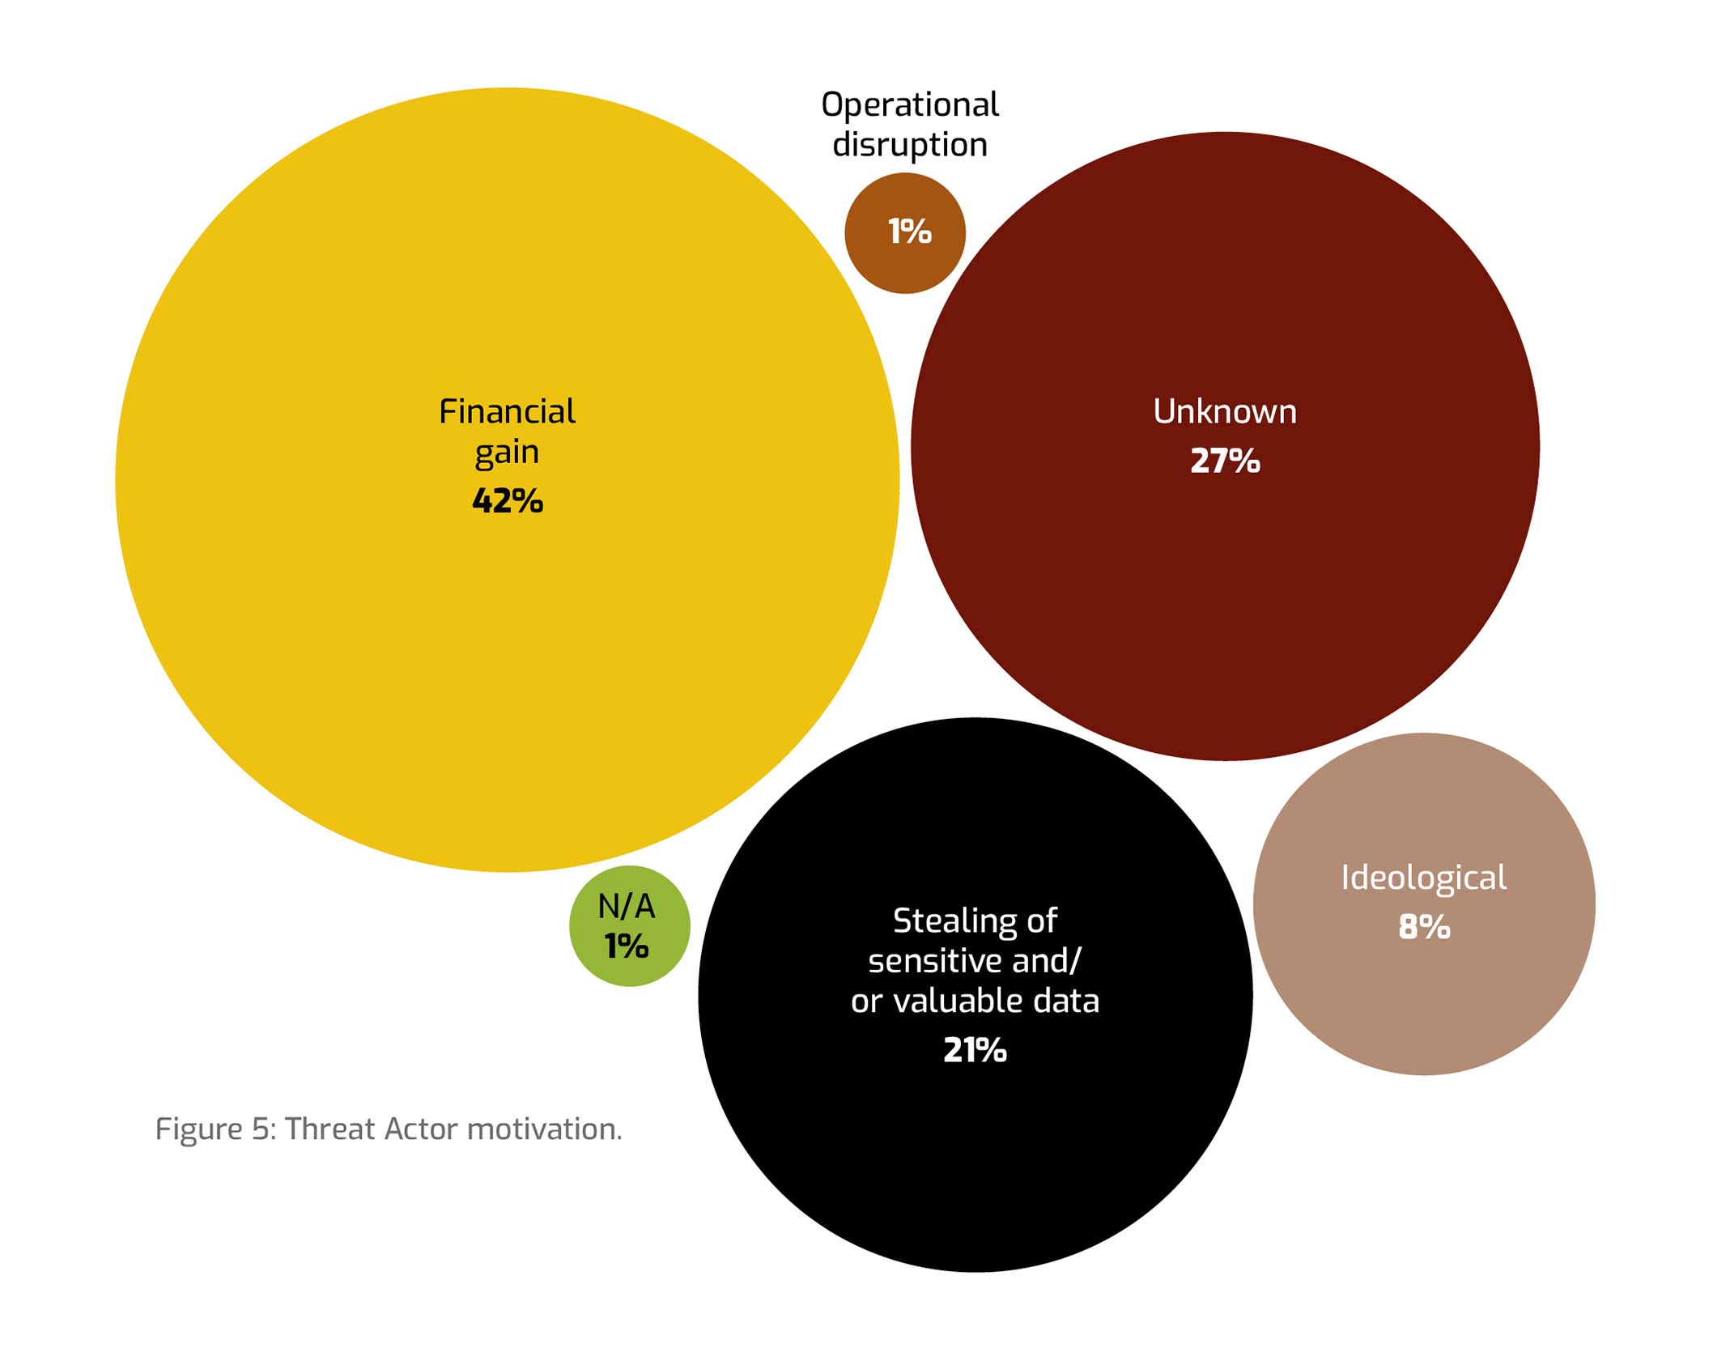
TLP:GREEN

Slide 10
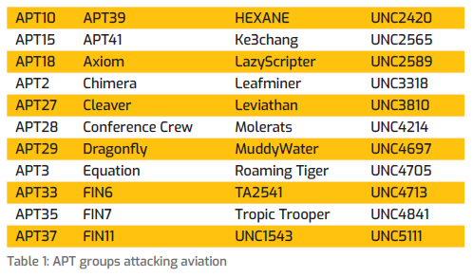
“Anticipate” how you can be attacked: MITRE ATT&CK Heatmap
6.320 events
+

Slide 11
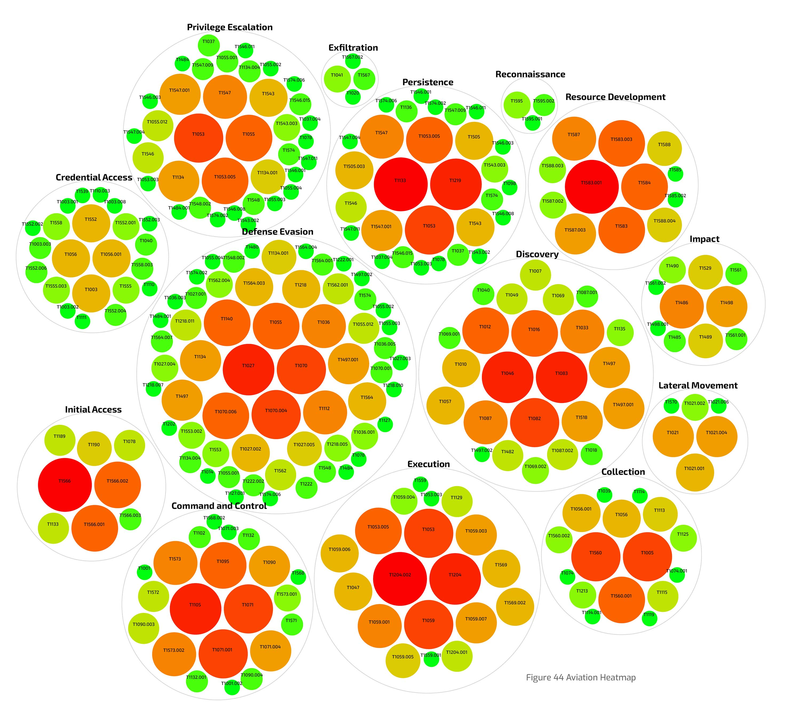
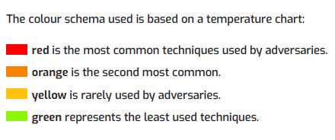
Aviation MITRE ATT&CK Heatmap

Slide 12
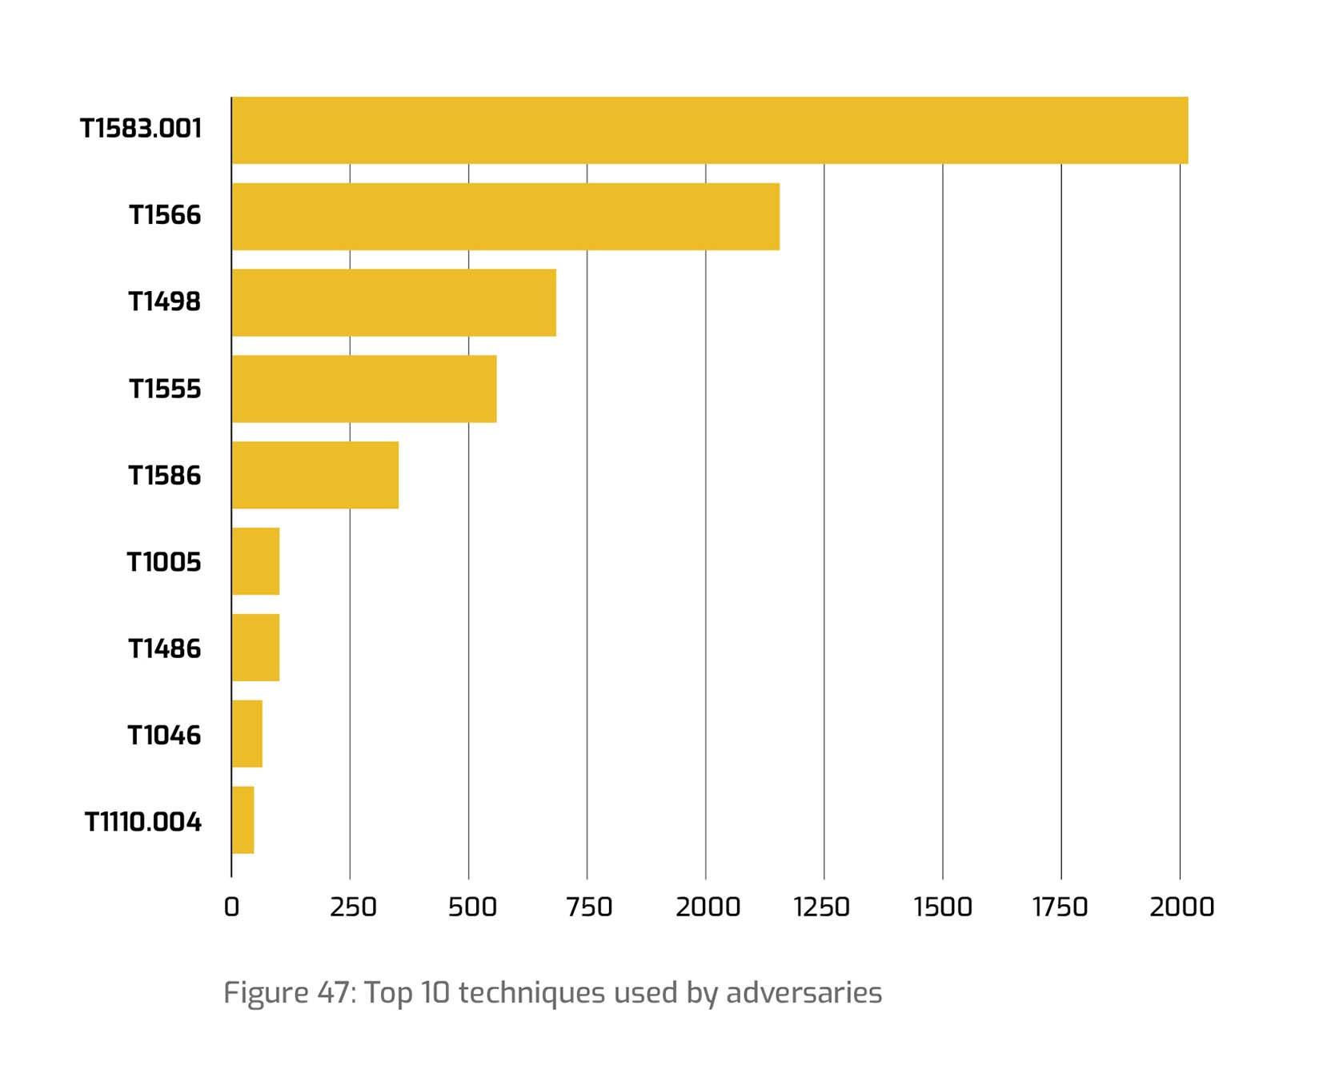
Aviation MITRE ATT&CK Heatmap
Compromise Infrastructure: Domains (T1583.001)
Phishing (T1566)
Network Denial of Service (T1498)
Credentials from Password Stores (T1555)
Compromise Accounts (T1586)
Exploitation for Credential Access (T1212)
Valid Accounts (T1078)
Command and Scripting Interpreter: PowerShell (T1059.001)
Account Manipulation (T1098)
Windows Management Instrumentation (T1047)

Slide 13
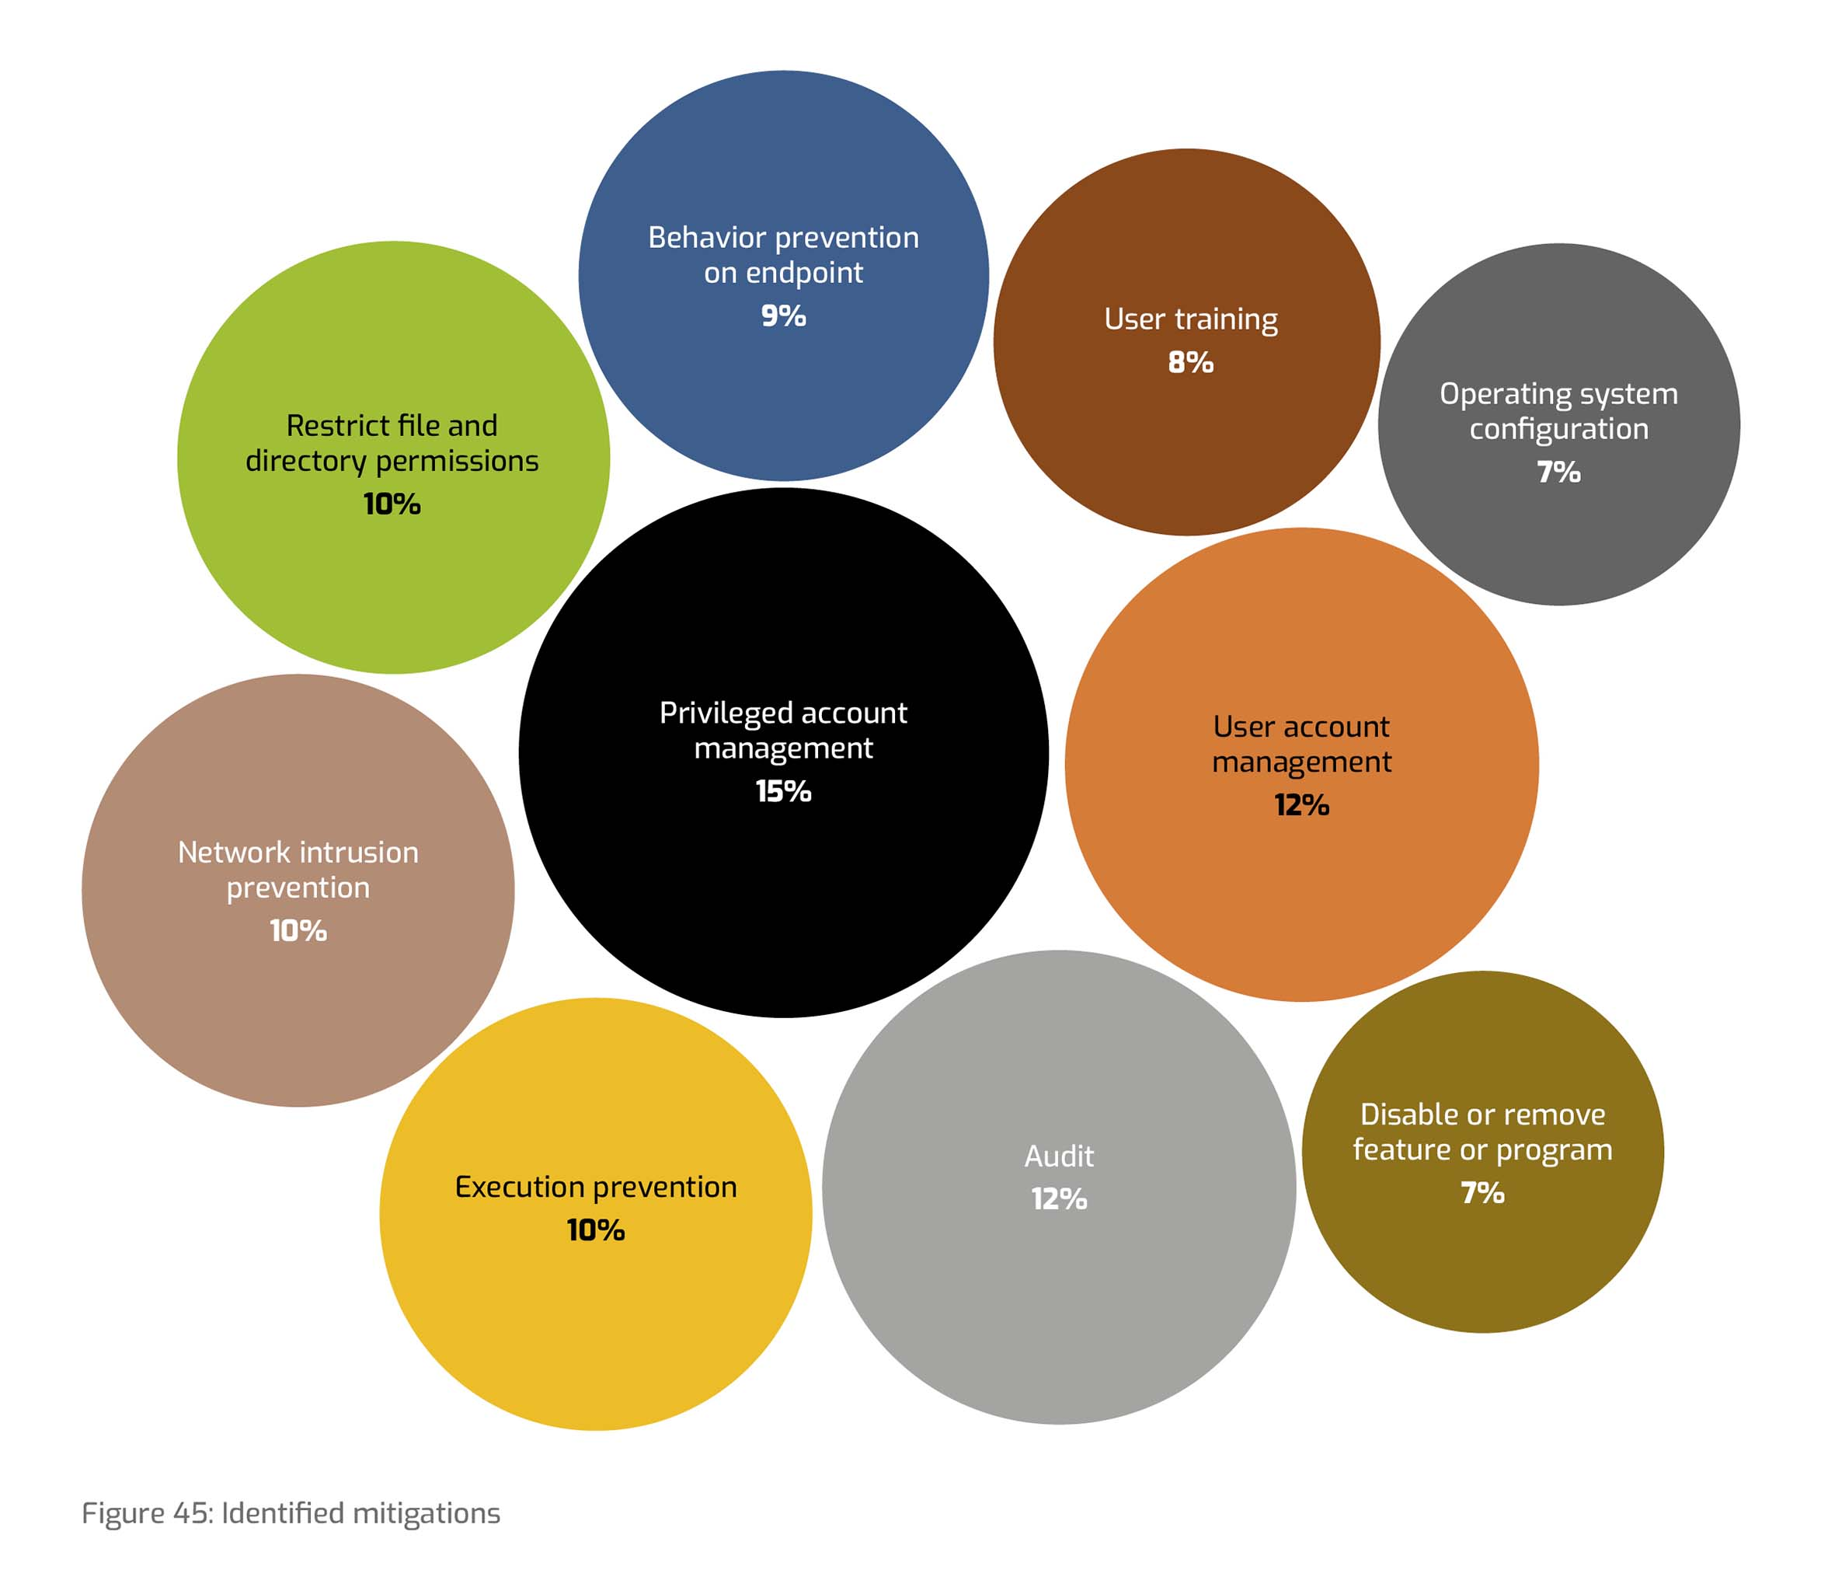
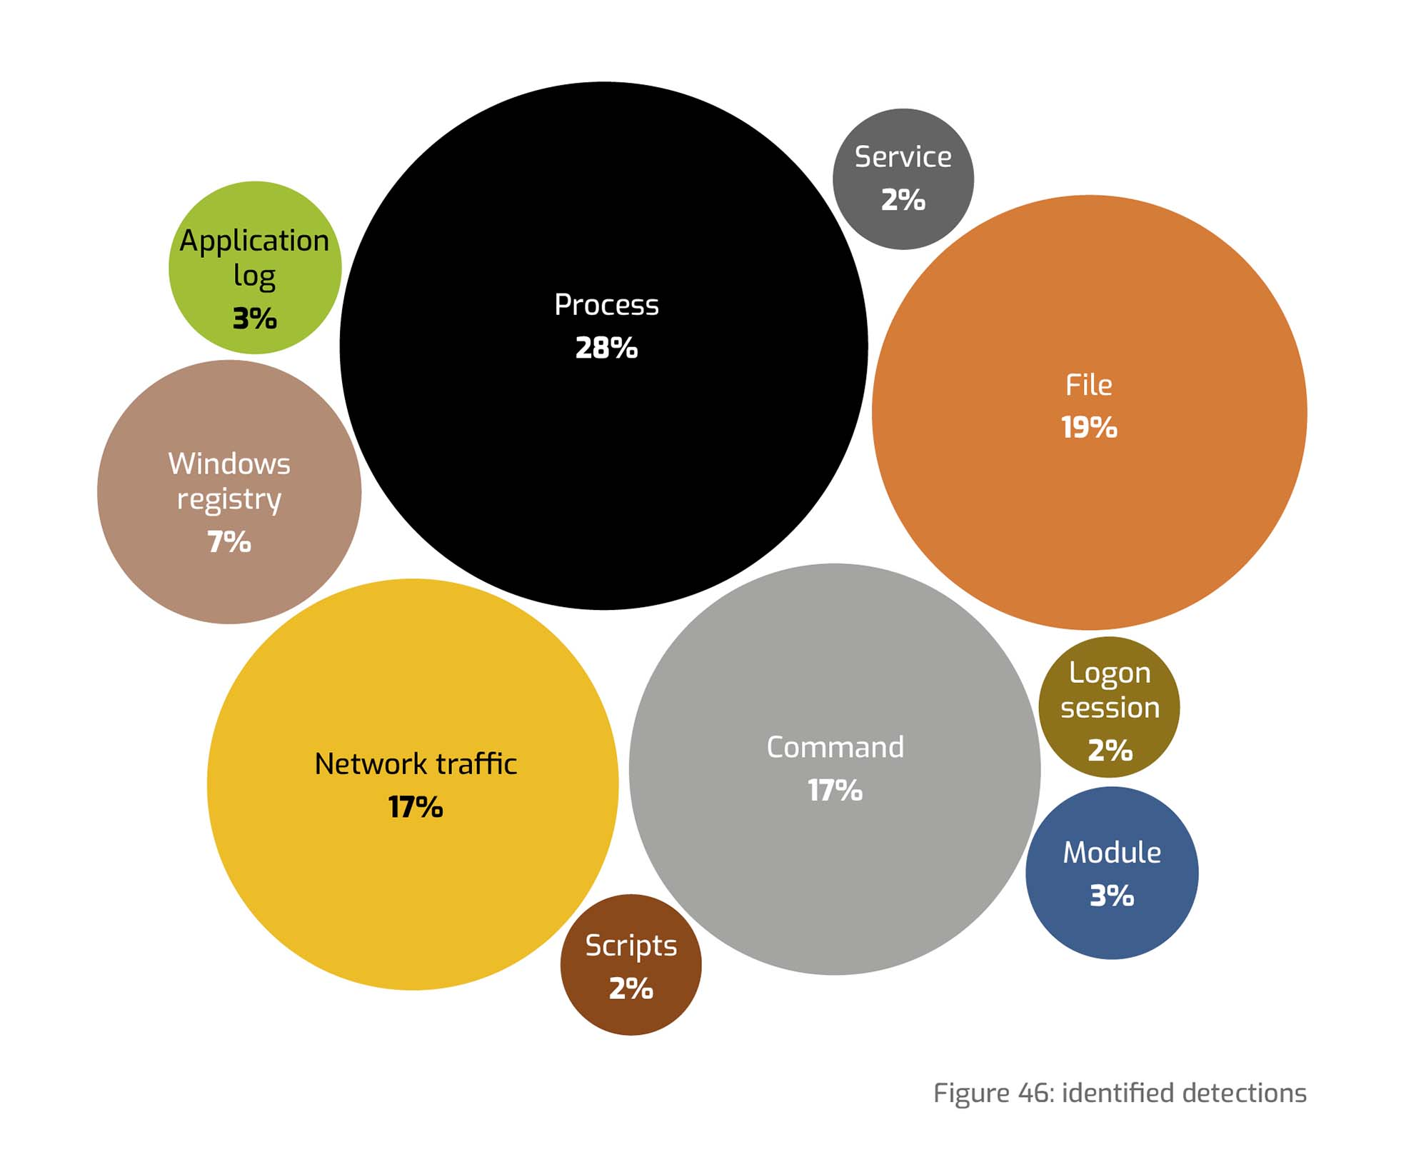
Aviation MITRE ATT&CK Heatmap

Slide 14
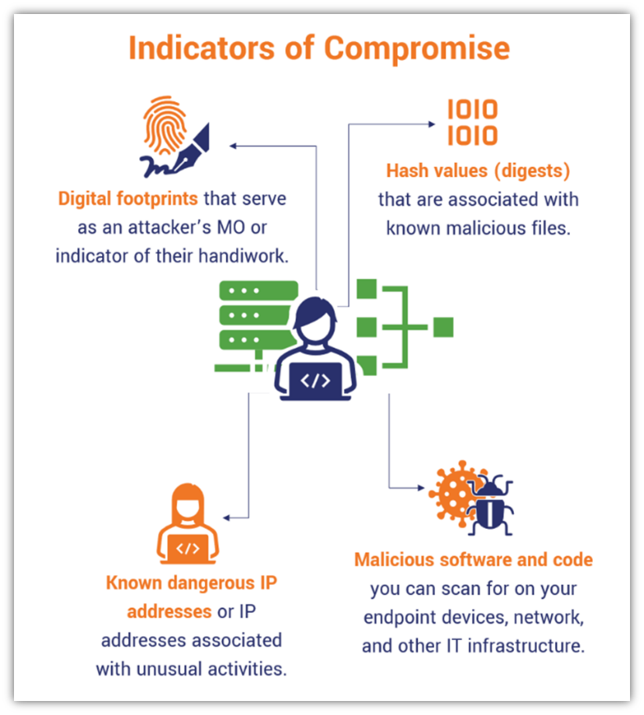
From IOCs driven to TTPs driven SOC

Slide 15
EACP

Slide 16
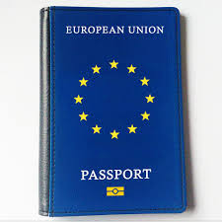












European Aviation Common PKI (EACP) A Building Block for the European Aviation Digital Infrastructure
EACP:
- Digital certificates to aviation stakeholders
- “Interop” of trusted Local PKIs
MET
Industry
M
I
L
ANSPs
Drone Operators
Airports
AIRSPACE USER
CAAs
EUROCONTROL
EACP
Aircraft Manufacturers
Local PKI
Local PKI
We are as strong as
the weakest link
Notes:
EACP aims at providing digital certificates for SWIM and for other applications
Two category of users:
Direct users that will use EACP certificates
Users have their local PKI that will become interoperable thanks to EACP

Slide 17
Thank you!
patrick.mana@eurocontrol.int
eatm-cert@eurocontrol.int
eacp@eurocontrol.int

Slide 18
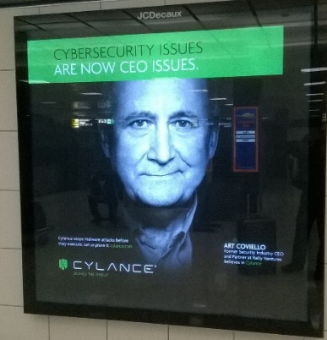
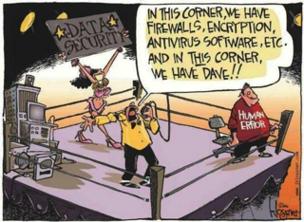
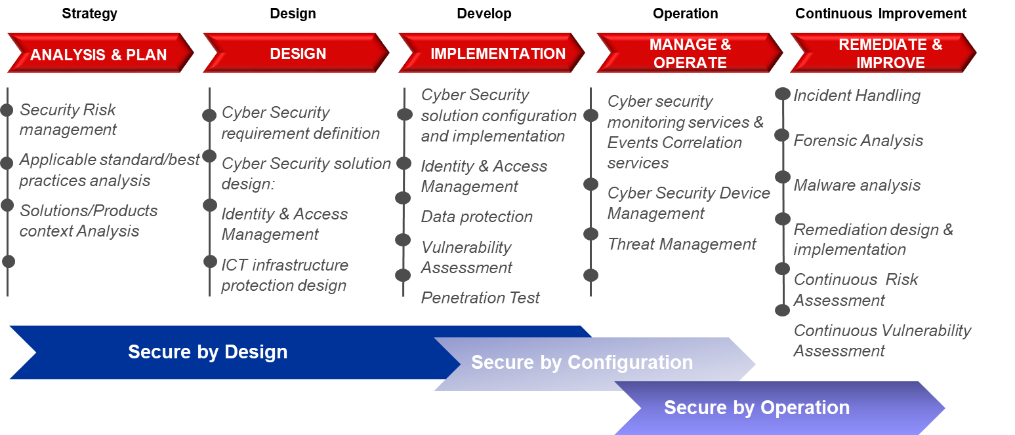
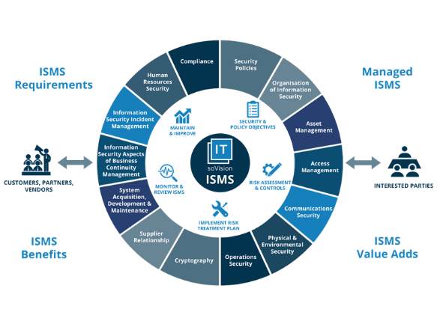



How?
Invest in Humans
Apply a secure development lifecycle
Adapt processes
Build a Trust Framework

Slide 19
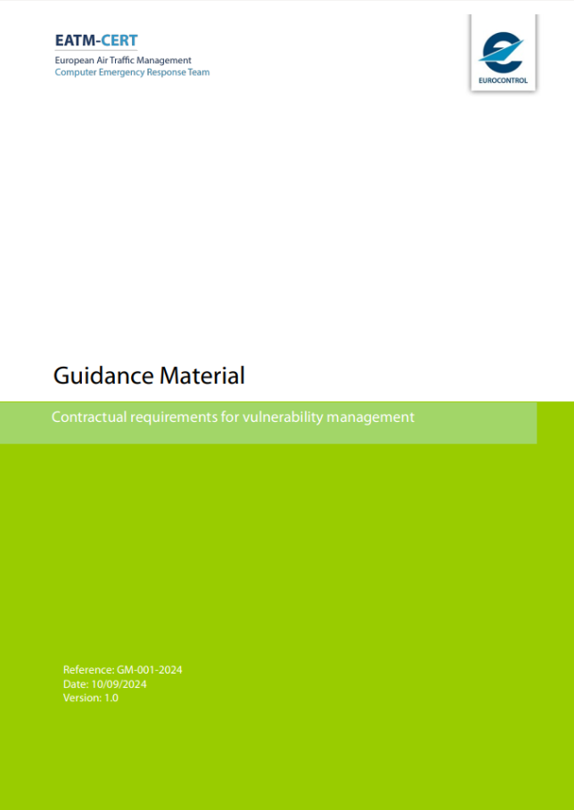

Manage your supply chain

Slide 20
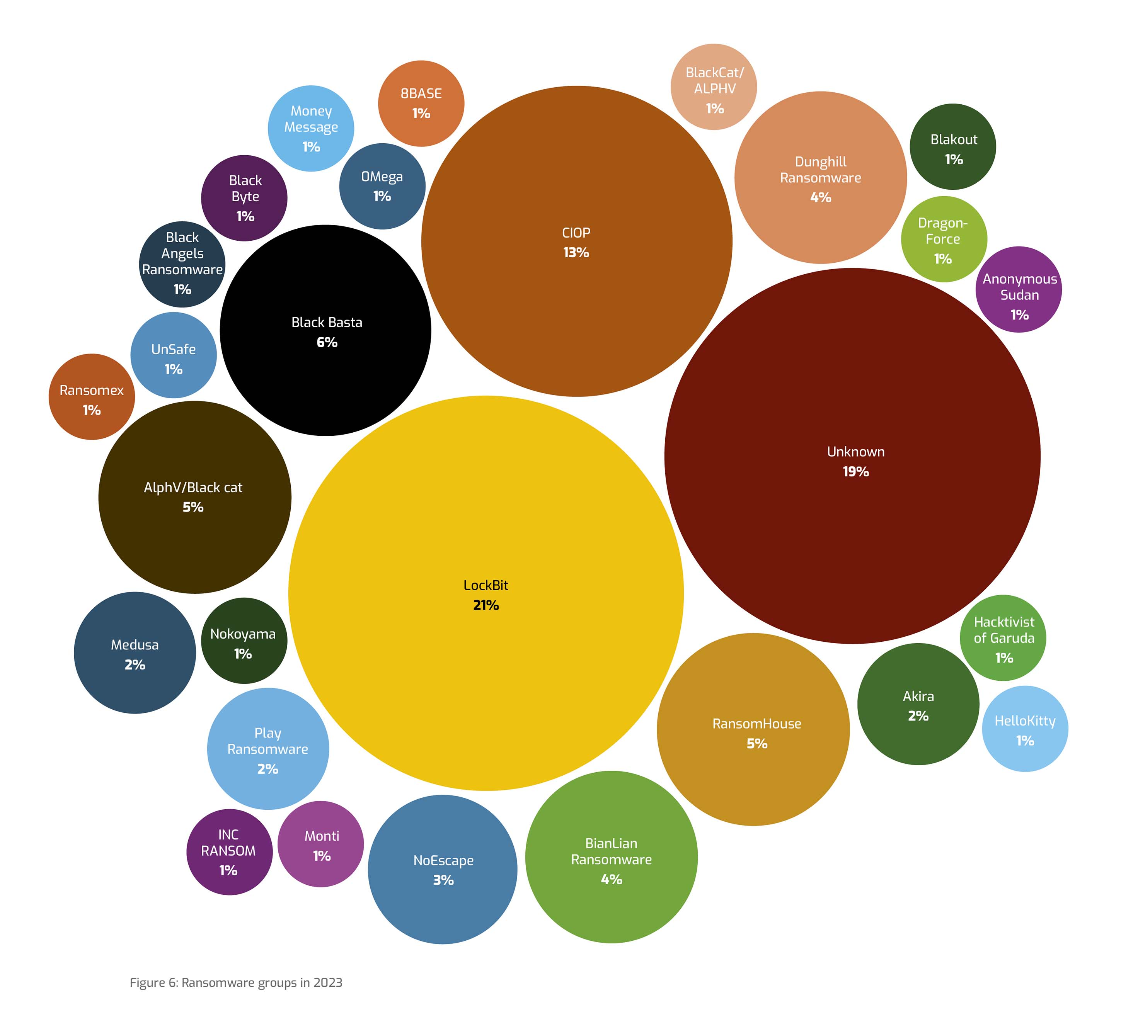
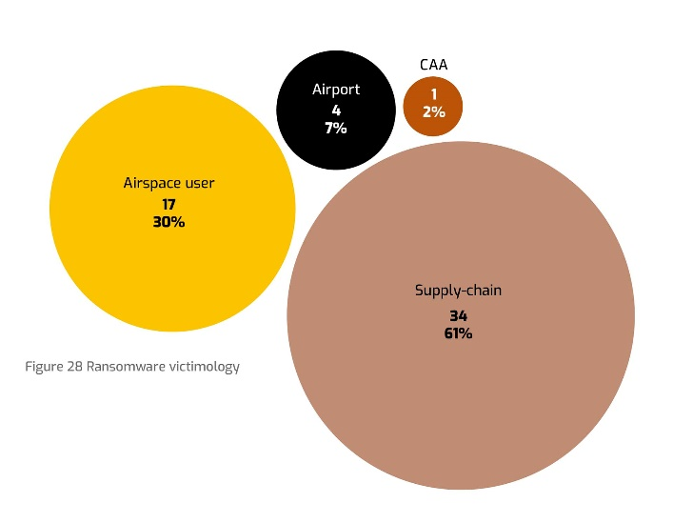
Ransomware on aviation
2023: 108 – (Mostly Supply Chain)
2022: 97
2021: 119
Main initial vectors:
Spearphishing
Stolen credentials
Double and even triple extorsion

