Slide 1
Innovation in practice - succeeding with technology-driven innovation in passenger transport
Kristian Kolind
World Passenger Festival, June 25th 2024

Slide 2
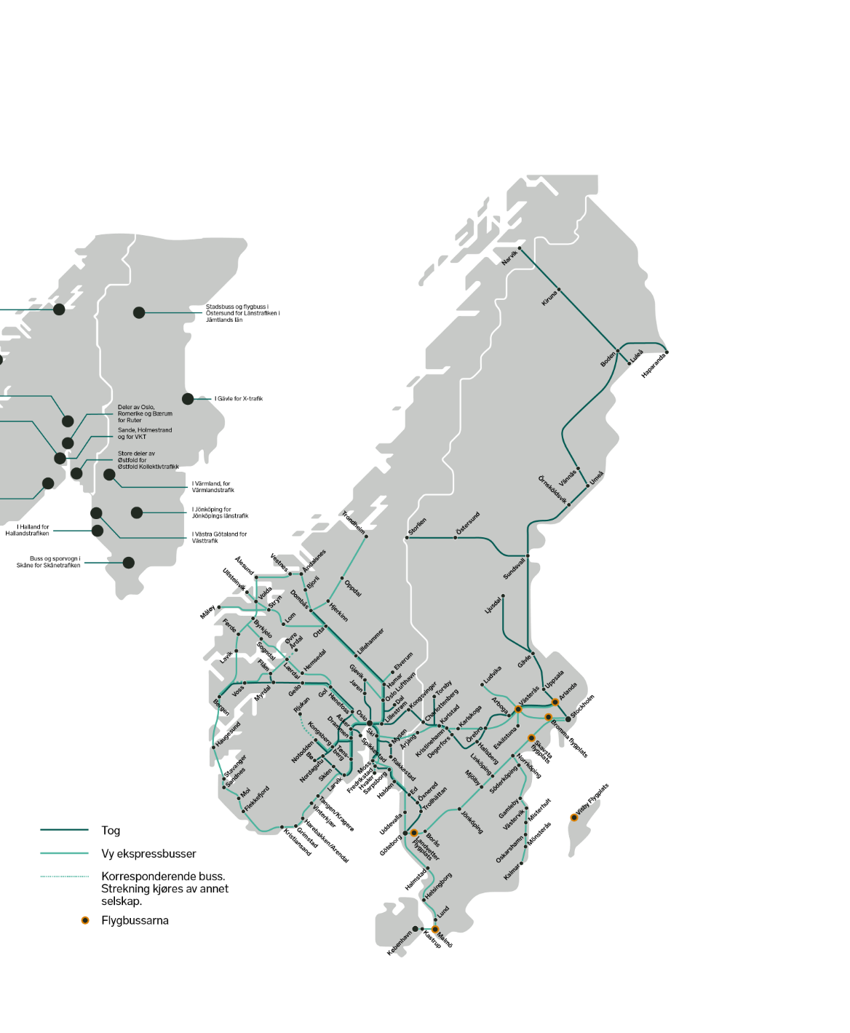
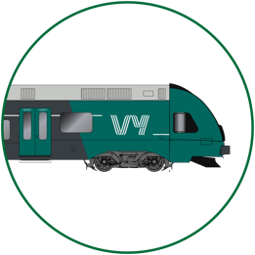
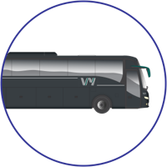


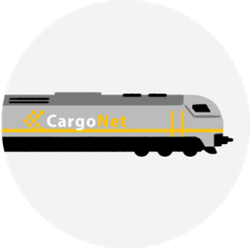

Vy is the largest land-based transportation company in Scandinavia
Passenger trains
Buses
Turnover: NOK 8,429 million
2,582 full-time equivalents
Turnover: NOK 8,466 million
6,021 full-time equivalents
Freight
Tourism
Turnover: NOK 1,268 million
470 full-time equivalents
Sustainable tourism products and packages
Trains
-
Express bus lines
-
Airport express buses
Cities with bus tenders

Slide 3

Vy’s vision: Make it easy to travel sustainably

Slide 4
What is innovation?
Notes:
First, some statistics…

Slide 5

Notes:
First, some statistics…

Slide 6

Notes:
First, some statistics…

Slide 7
Innovation (noun)
/ˌɪn.əˈveɪ.ʃən/:
”Commercially applied ideas”
...to benefit customers or reduce costs
...put to use...
Something new or changed...
Notes:
First, some statistics…

Slide 8
Three categories of development
Product offering
New
Innovation
Business development
Improvement
Existing
Market
Existing
New

Slide 9


Vy’s current development portfolio has varying degrees of innovation and maturity
Degree of development
Full size autono-mous bus
Innovation
Electric car sharing
Business development
Improvement
Customer facing innovation
Maturity
Backoffice innovation
Exploration
Development/ test
Operative/ scaled
Killed

Slide 10
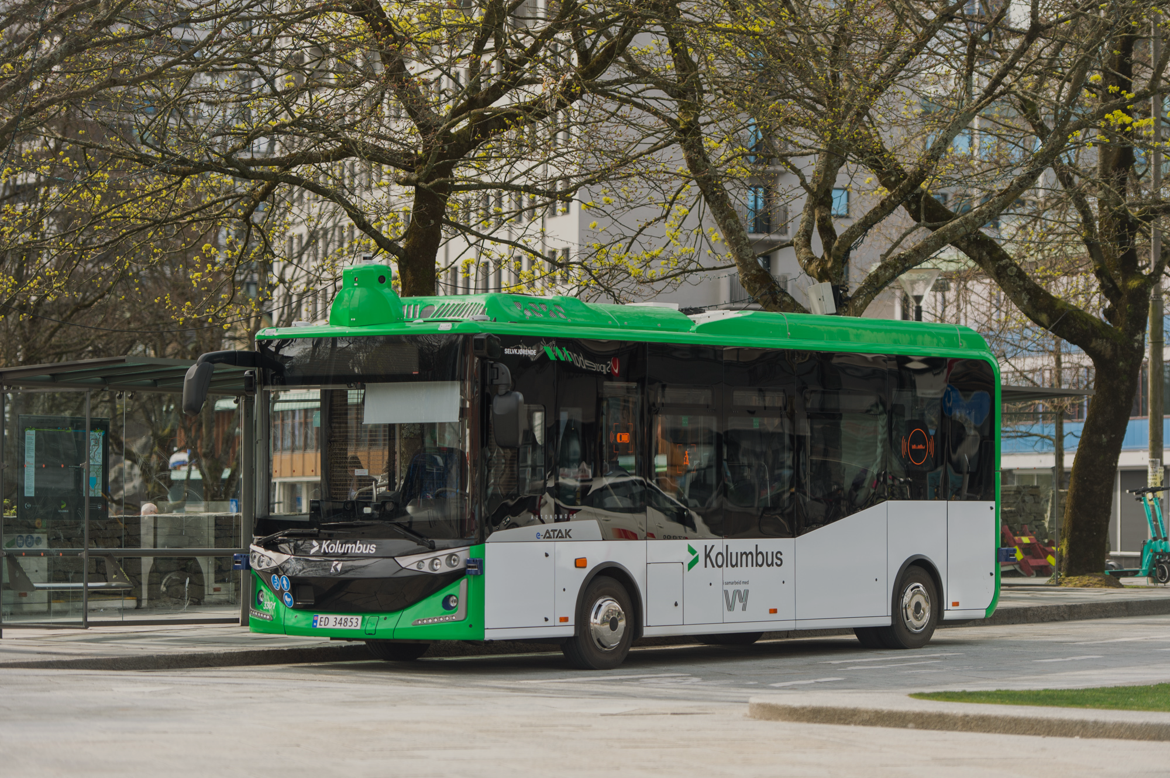

Full size autonomous bus
In operation in Stavanger, Norway since 2022
Open for paying customers
Complex route in the city centre, including roundabouts, traffic lights and a tunnel
Goal of driverless operation in late 2024.
40 km/h top speed, goal 50 km/h
Partners: Kolumbus, Vy, Adastec (Autonomy), Karsan (Bus), Applied Autonomy (Op.plattform)
Won Innovation Award at Autonomy Mobility in Paris 2023

Slide 11

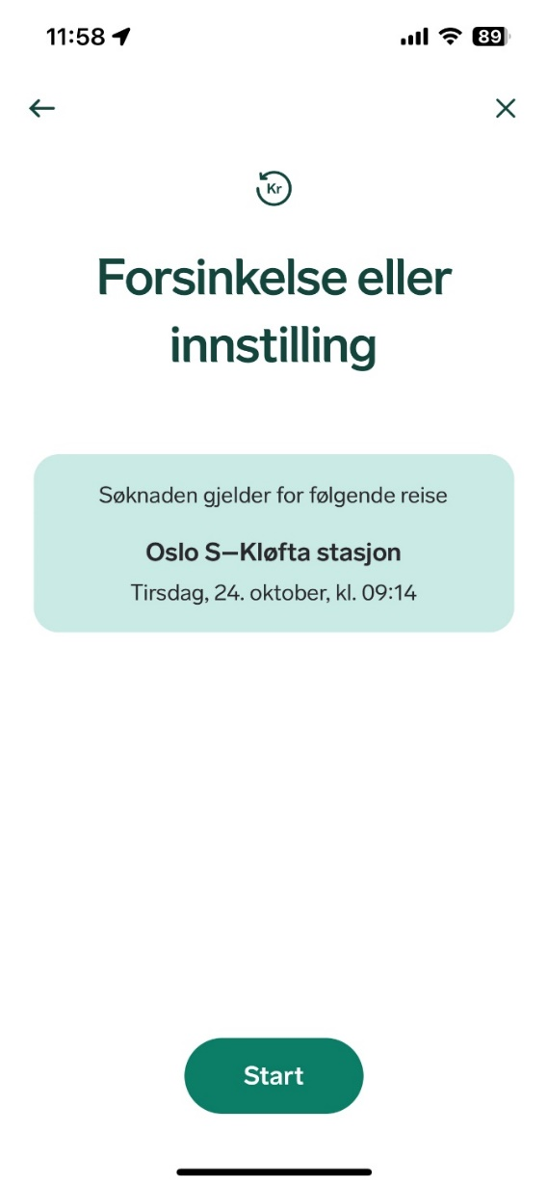
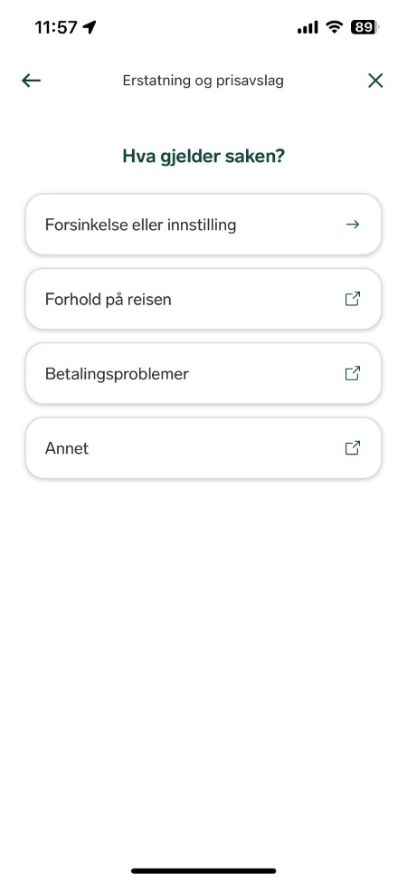
Self service refund
Problem: Massive increase in ticket refund requests
Solution: Automatic processing of customer requests for ticket refunds
Customer ticket info is verified against actual traffic delay data
Status: Deployed late 2023, automation share now 28%

Slide 12

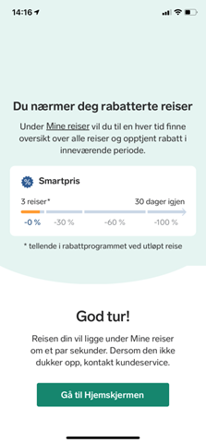
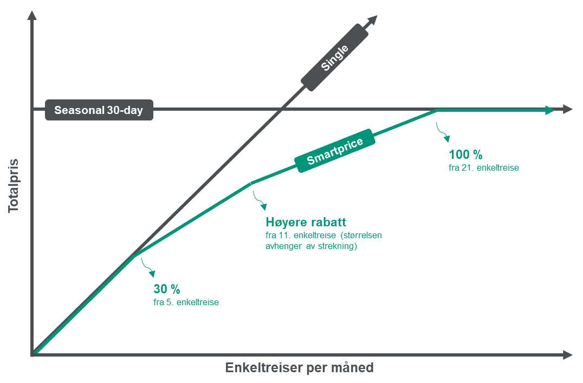
Fare capping – Smartprice
Problem: more homeoffice, hybrid weeks and less need for seasonal 30-day tickets
Solution: Capping model
The more you travel, the
higher the discount and the capping is done at the price of a 30 day ticket
Status: Deployed 2020 and 20% of all revenue is Smartprice-tickets

Slide 13
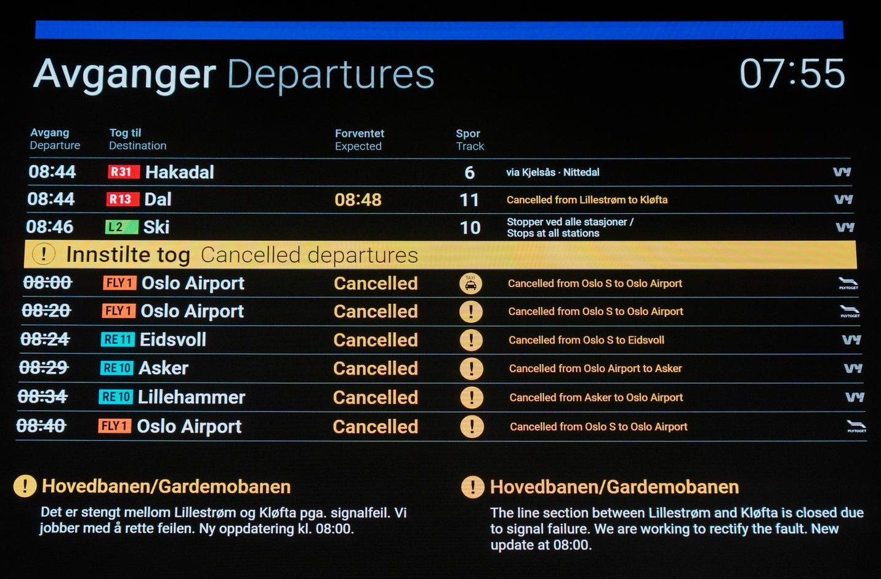
Real time tracking of train replacement buses
Problem: In case of traffic disturbance, customers have limited info about alternative transportation options
Solution: App with GPS-tracking for contracted bus drivers, time estimation through machine learning
Status: In testing

Slide 14
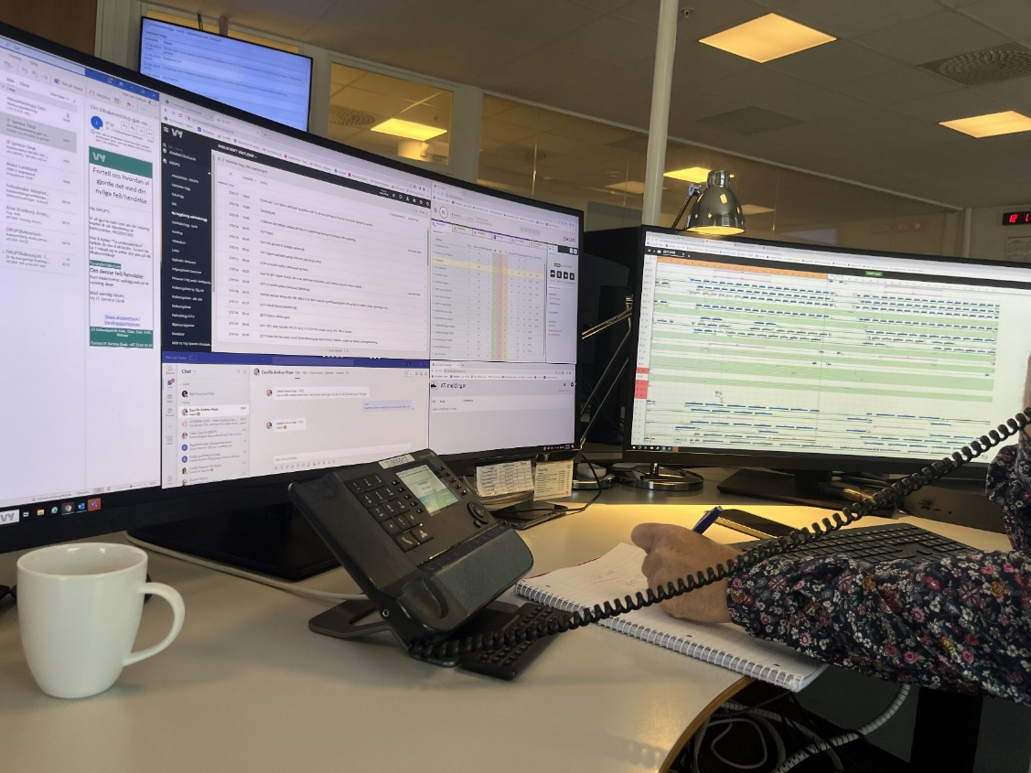
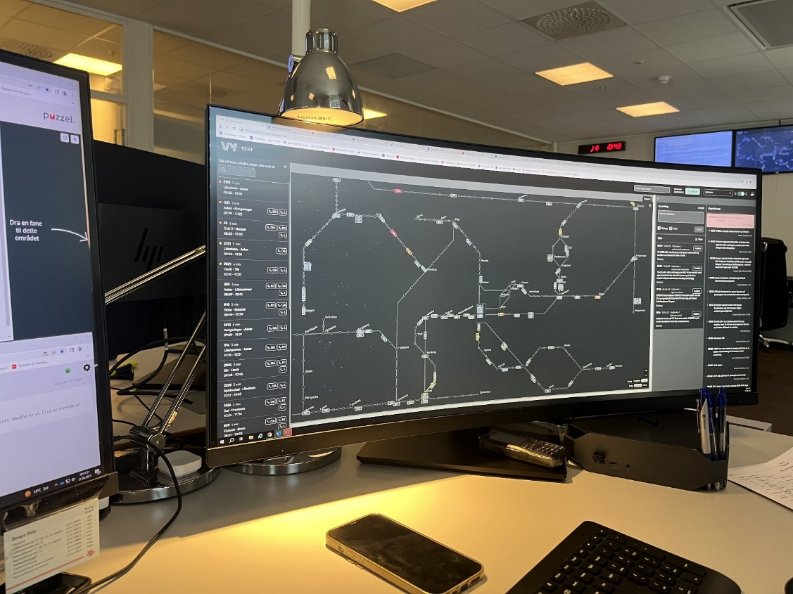
Operations centre dashboard
Problem: The traffic operations centre has to do a number of manual tasks during complex traffic disturbances
Solution: In-house developed simple user interface with a degree of automation
Status: In operation

Slide 15
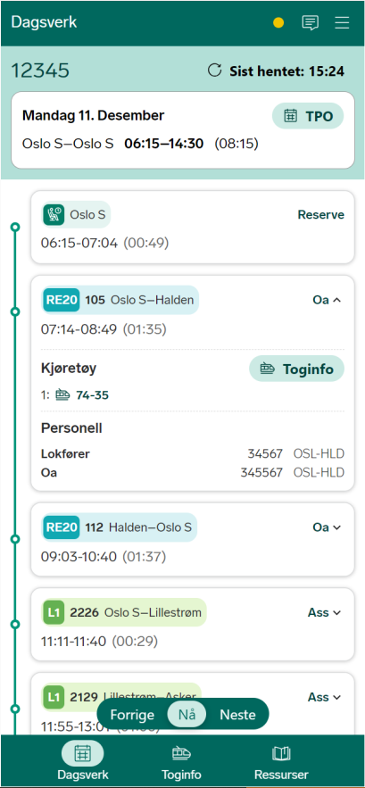
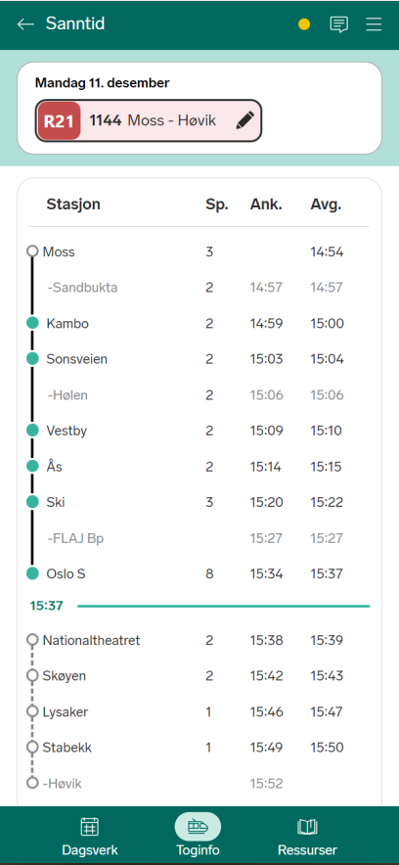
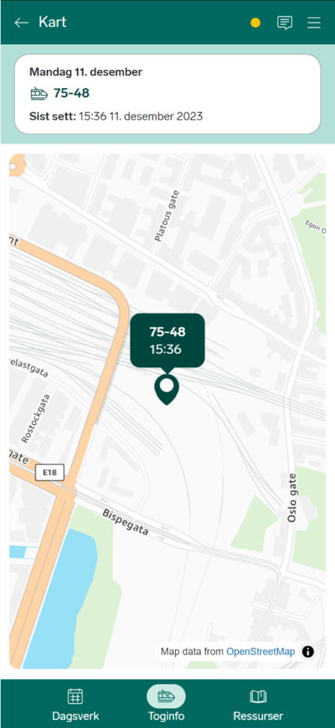
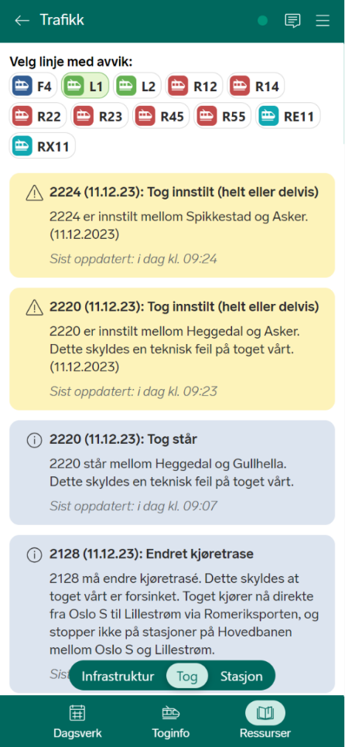
Train driver app
Problem: Train drivers and conductors do not always have updated information- at hand
Solution: In-house developed app with all relevant info, including deviations
Status: Implemented

Slide 16
IT tech readiness is an important catalyst for innovation
IT prerequisites for innovation
Modular and flexible IT architecture
Shared and modern data platform
Product owner (BU)
Develop-ment
Domain experts (BU)
Product domain
(xOps)
AI/
machine learning
IT security
State of the art tools for developers
Cross-functional way of working that includes AI competence
Robitisation/Automation
IT operations

Slide 17



Viability:
Can we make money from it?
Feasibility:
Can we do it?
Desirability:
Does the customer want it?

Slide 18
Desirability:
Does the customer want it?
Feasibility:
Can we do it?
Viability:
Can we make money from it?

Slide 19






We have developed our own innovation process where we either validate or reject ideas through exploration and testing in four clearly defined phases
Continuous learning and adjustment
Continous development
PRIORITIZED IDEA
HANDOVER TO BUSINESS
Explore need
Draft solution
Develop solution
Launch and scale
Does the customer want it?
Does the solution meet the need?
Can we build it? Is it profitable?

