Slide 1
Balancing children's capabilities with efficiency when planning additonal needs transport
World Passenger Festival
Vienna | June 2024

Slide 2
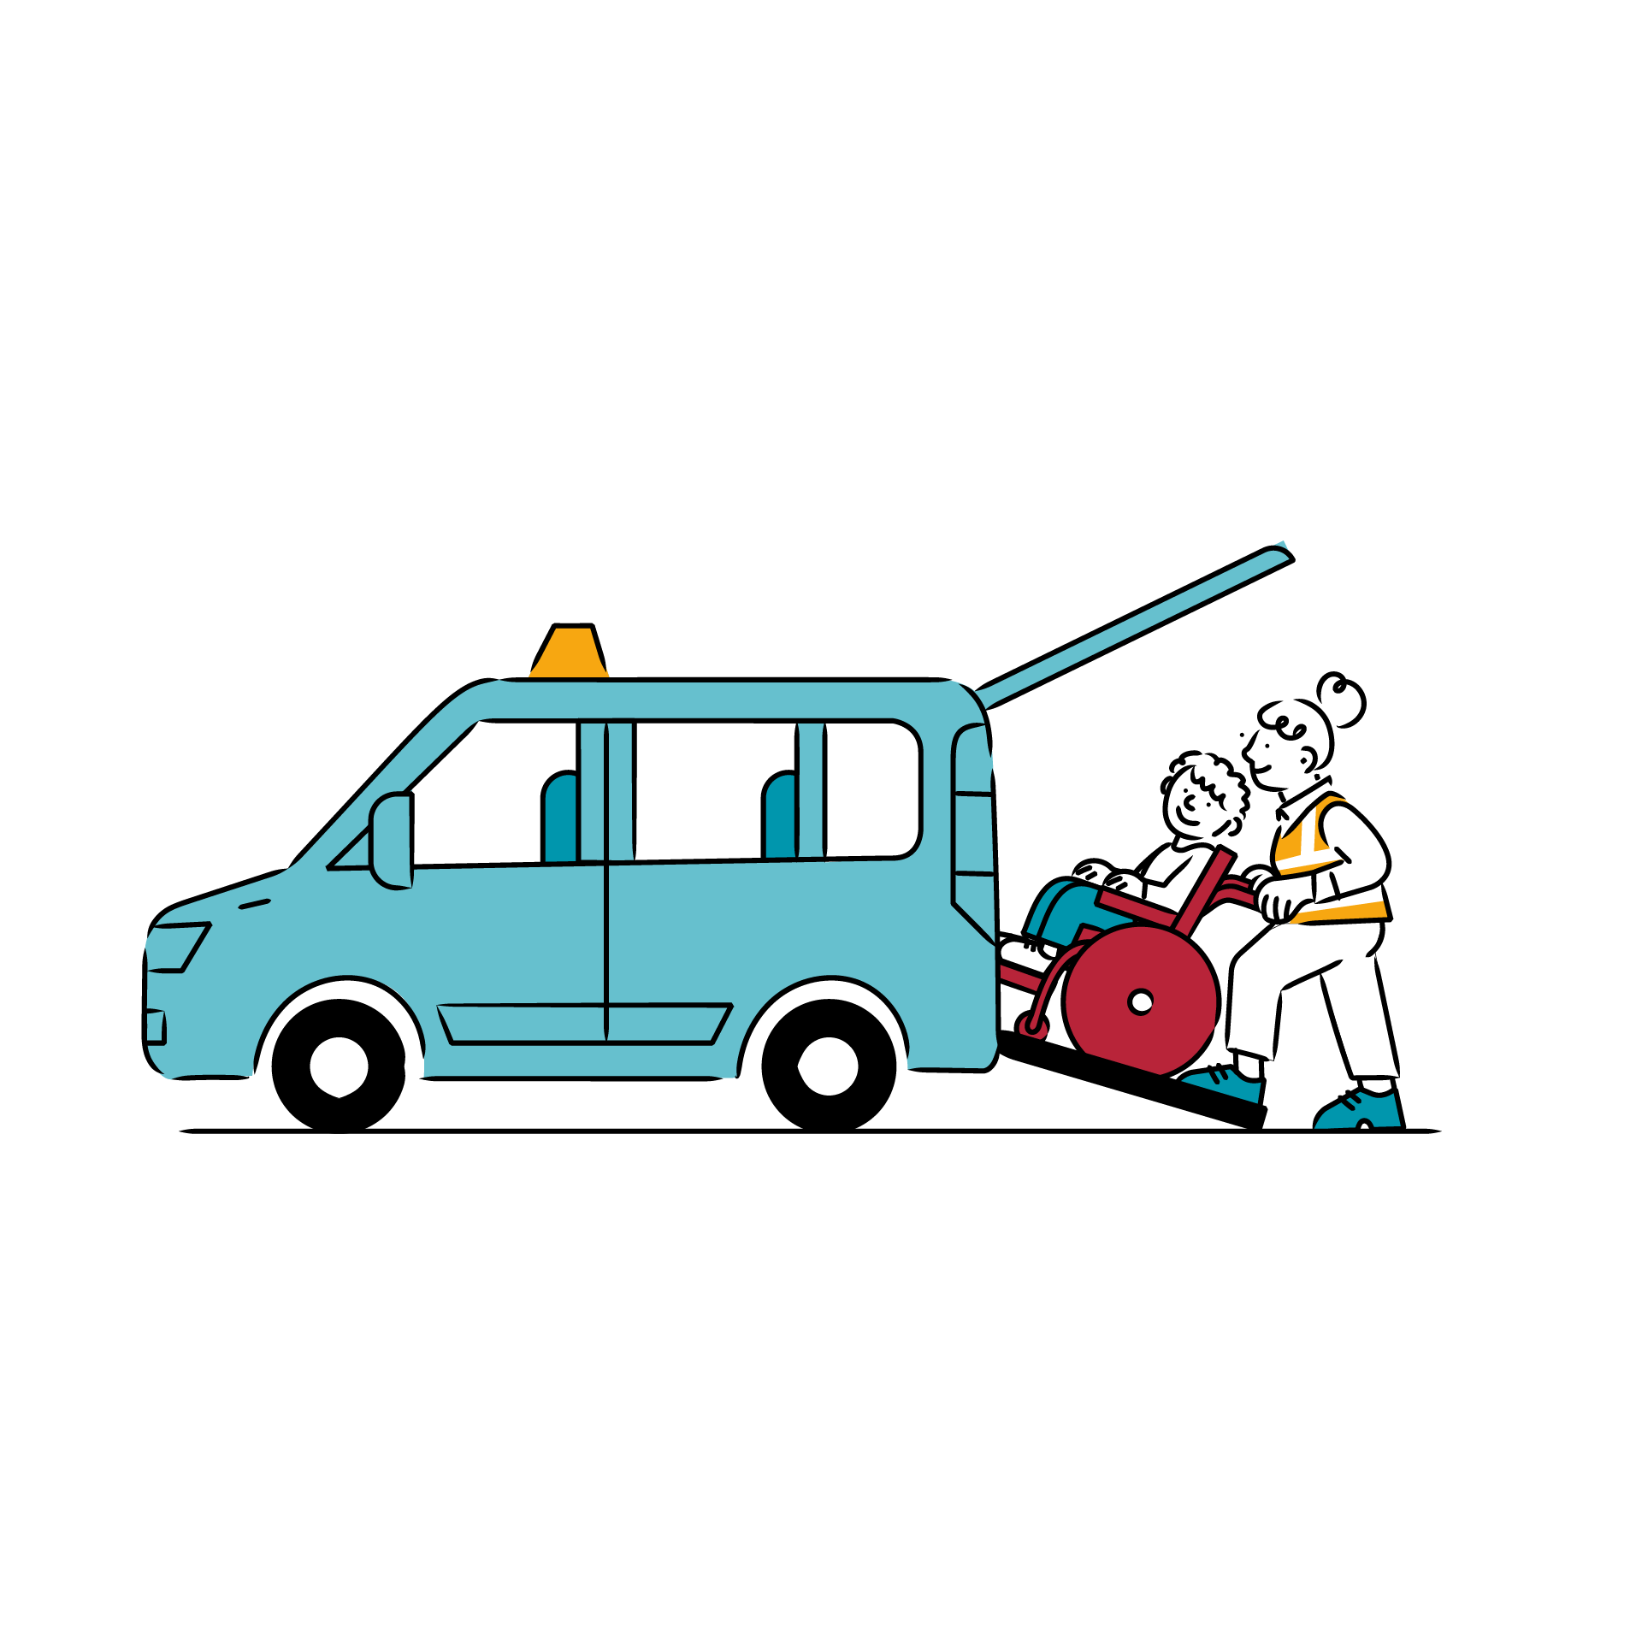
What we'll cover
Background to school transport
Why 70+ local authorities use QRoutes
QRoutes Vantage
Examples

Slide 3


Slide 4

School Transport in the UK
Legal duty for for children with additional needs (SEND)
Public spend currently in estimated at
£1,400,000,000 (SEND & Mainstream)
SEND – Special Educational Needs and Disabilities - is an umbrella term

Slide 5
School Transport in the UK

Slide 6
Routing is hard
Complexity
Demand

Slide 7
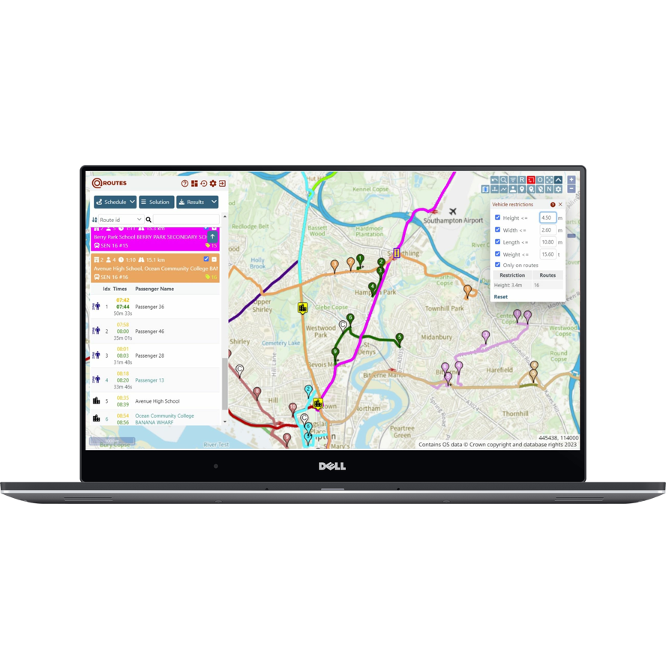
Why QRoutes
Fast
Effective
Intuitive

Slide 8



At one school in East Sussex...
3 hours - passenger travel time saved
46% - mileage (km) saved
£274,692 p.a. saved (33%)

Slide 9
Improve value for money
Local authorities
increasingly want to know
'Where can we do better?'
Cut the number of taxis
Pros and cons of alternative fleets

Slide 10

QRoutes
Vantage

Slide 11

QROUTES VANTAGE – the approach
Without Vantage
With Vantage

Slide 12
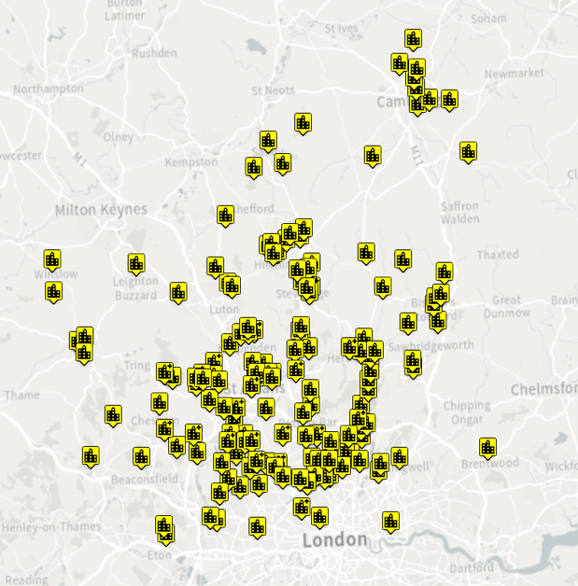
'How can we reduce the number of single occupancy taxis?'
Hundreds of schools
Over 50% of schools have less than 5 students
The specialist schools at one UK local authority

Slide 13
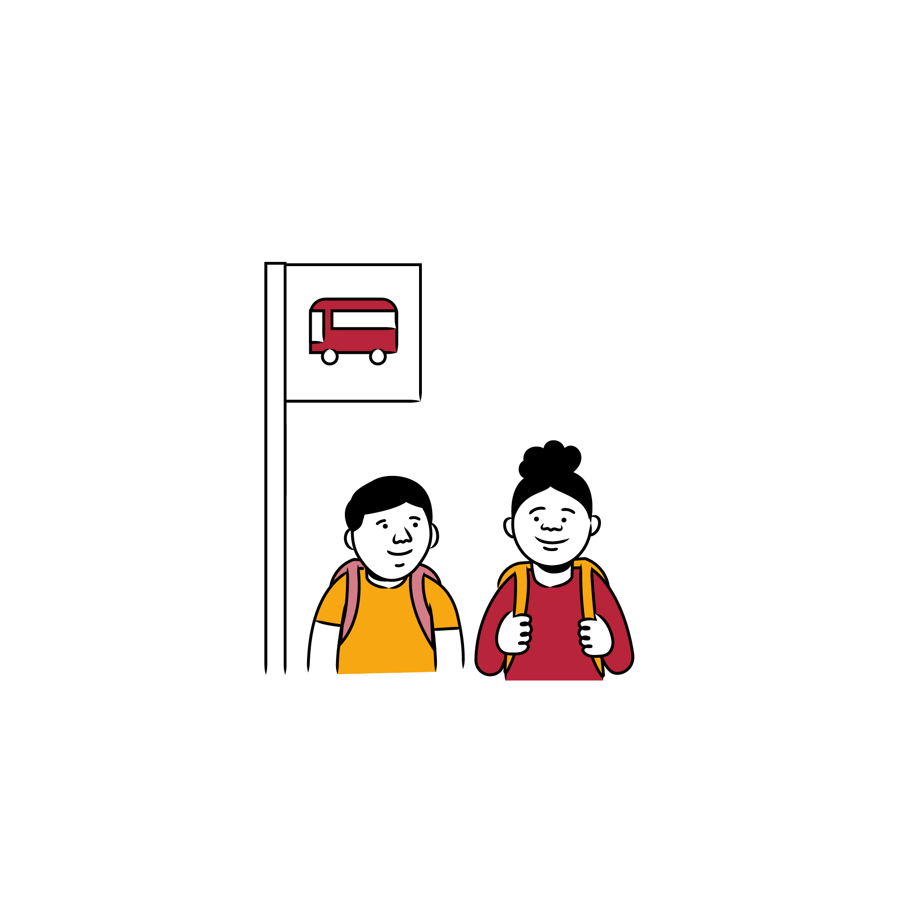
'How can we reduce the number
of single occupancy taxis?'
Vantage identified
which single-occupancy routes could be merged into others
opportunities for sharing across schools
possible policy changes (e.g., changing entitlement)

Slide 14


Building the business case for investment in a new fleet of vehicles
'Will we save money if we invest £2m in new vehicles?'
Proposed vehicle layout
2 wheelchair places
3 standard seats

Slide 15
Building the business case for investment in a new fleet of vehicles
'Will we save money if we invest £2m in new vehicles?'
Proposed vehicle layout
2 wheelchair places
3 standard seats
Yes! You'll save £600,000 per annum

Slide 16

'Will we save money
if we invest £2m in new vehicles?'
'Will we save money if we invest £2m in new vehicles?'
Proposed vehicle layout
2 wheelchair places
3 standard seats
With vehicle layout
1 wheelchair places
5 standard seats

Slide 17

'Will we save money
if we invest £2m in new vehicles?'
'Will we save money if we invest £2m in new vehicles?'
Proposed vehicle layout
2 wheelchair places
3 standard seats
With vehicle layout
1 wheelchair places
5 standard seats
You'll save £1,500,000 per annum

Slide 18
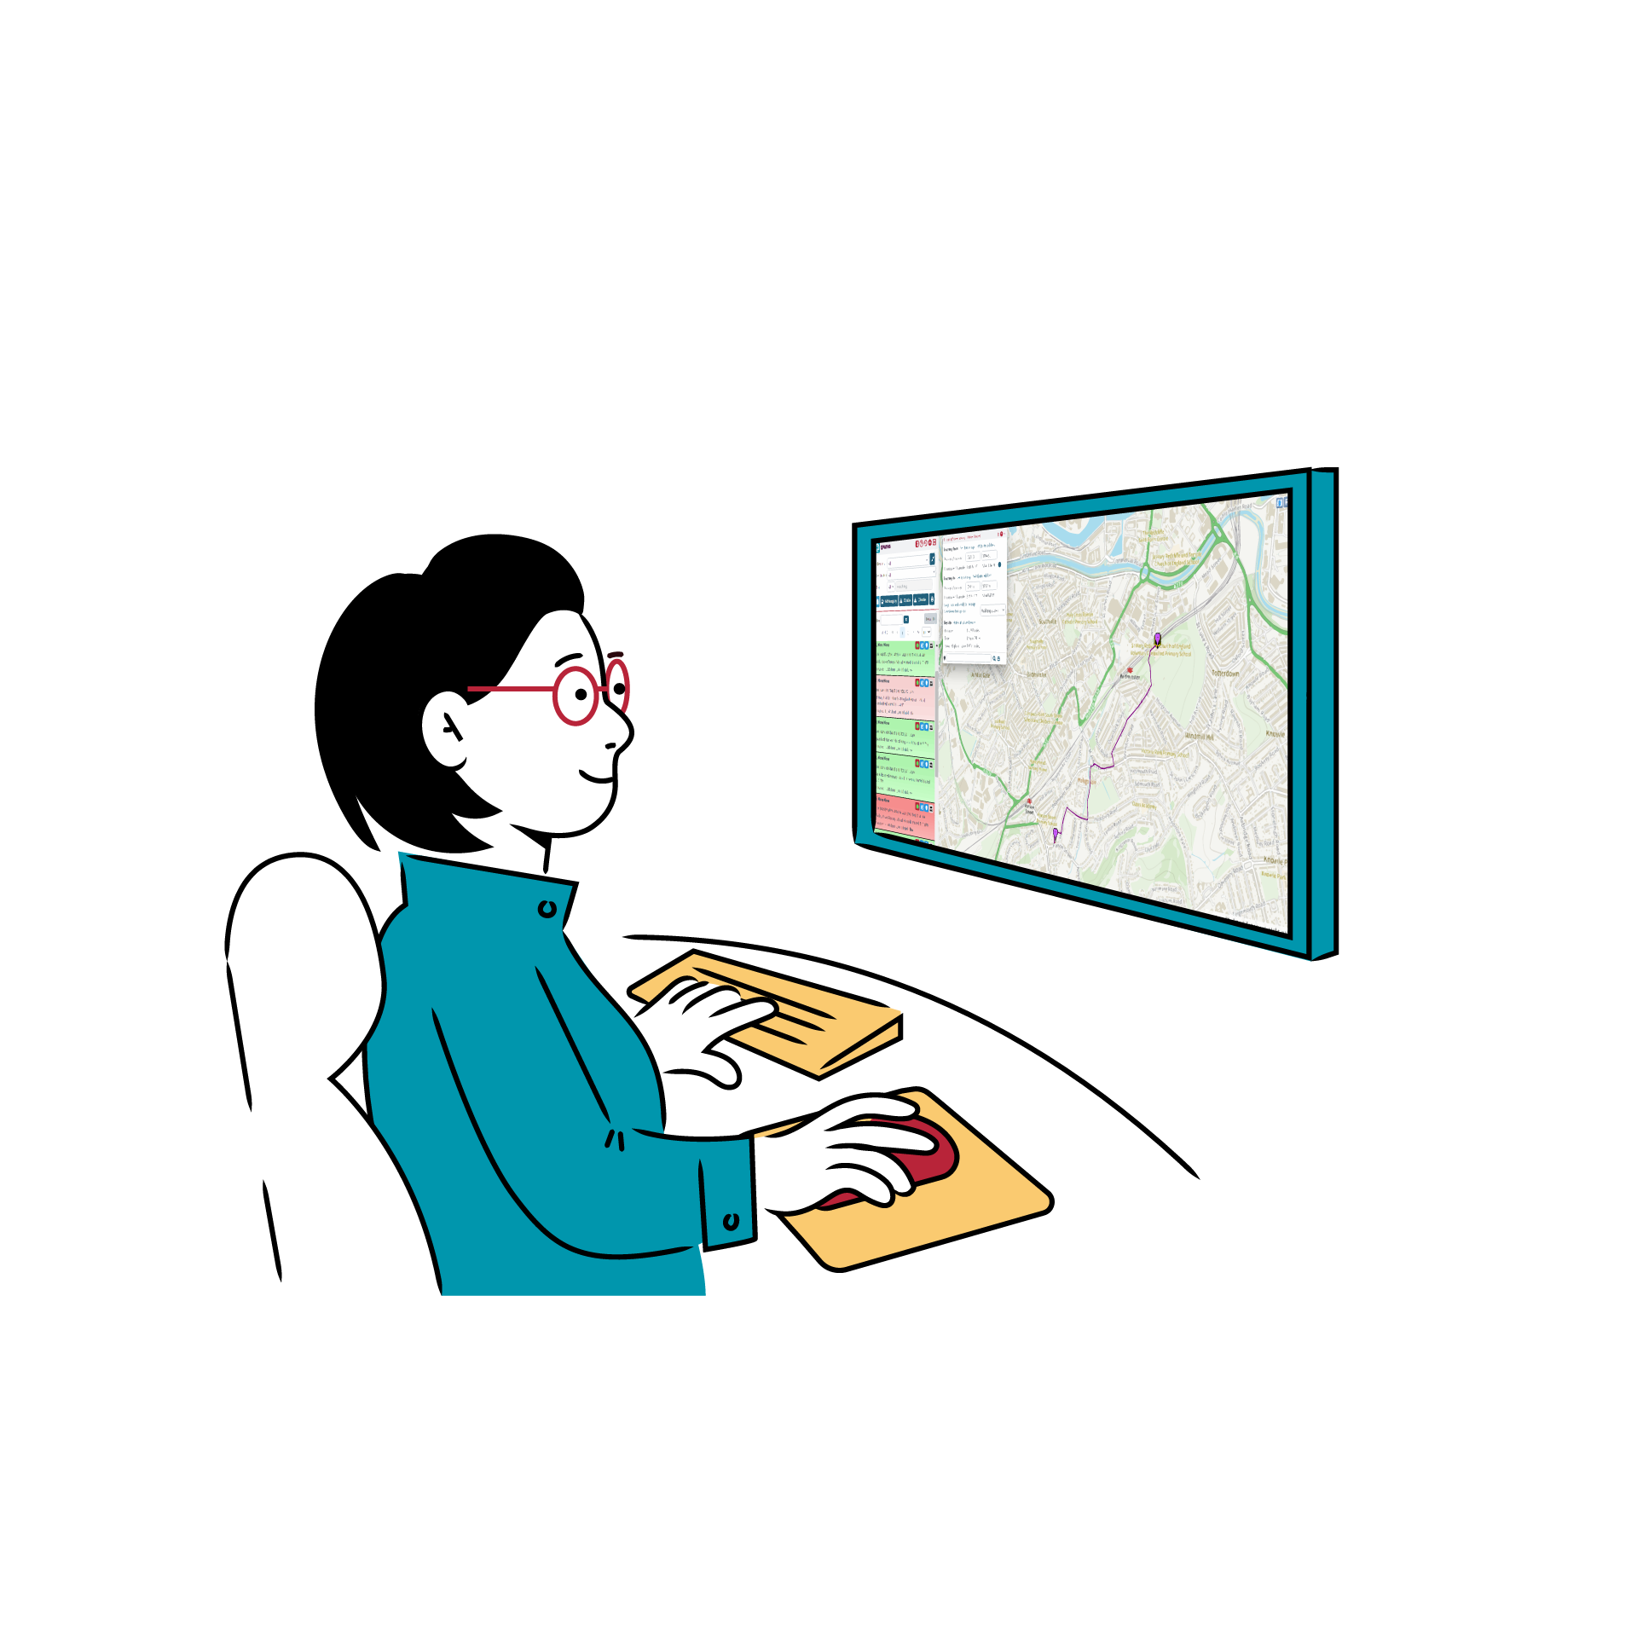
In summary
Saves time
Cuts distance
Reduces cost
Confidence and clarity for planning teams

Slide 19
We're looking for partners
Get in touch
Liz Davidson liz.davidson@qroutes.co.uk
Stand 14 World Passenger Festival

