Slide 1
Smart Rail Security 2025:
Introducing AI to prevent copper thefts and sabotages
Ignacio González Medina
Managing Director BauWatch Spain
Notes:
Classification: NOTE that you need to classify the security level of each presentation by adding it on the title slide. 1) “Secret” – only for the people this is sent to; 2) “Confidential” – only for BauWatch internal usage 3) “Business Confidential”: for the people it is shared with (internal & external); 4) If you don’t mark it, it appears as being “public”.

Slide 2
69%
Experience thefts at the projects

Slide 3
62%
Copper
1.500
m euro
60%
Small tools
every year
56%
Cables

Slide 4
Why Traditional Security Isn’t Enough
Patrol services can’t monitor projects 24/7
Human limits
      01
25% confirms that insiders were involved
02
63% of professionals say criminals are getting more sophisticated
03
04
At least 15K€ per month are needed to organize 24/7 monitoring by patrol and security guards
Notes:
Organised networks- 36%
More coordinated and organised operations 46%
More stealthy tactics 45%

Slide 5
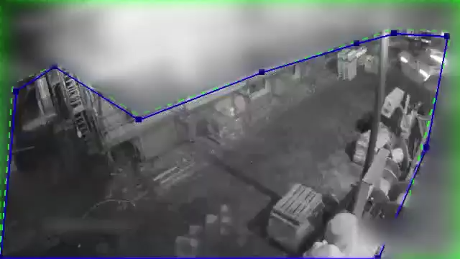

Introducing AI for Rail Security
BauWatch technology monitors, detects and neutralizes intrusions in real time 24/7

Slide 6
Three Levels of filtering to Verify Alarm
      Tier 1:
        AI basic motion detection incorporated in cameras.
      Tier 2:
        Second Tier Analytics (STA). BauWatch developed solution to analyse and classify objects.
      Tier 3:
        Human verification of the alarms by registered security guards at Alarm Receiving Centre (ARC).

Slide 7
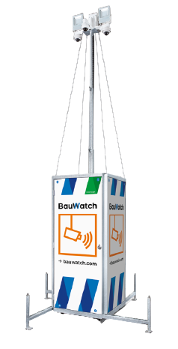









      Tier 1:
      AI basic detection incorporated in cameras
Only reduce
false alarms
up to 10%-20%
Notes:
It independently identifies potential objects that require extra attention
Detects 400K objects every week

Slide 8







      Tier 2:
      BauWatch Second Tier Analytics (STA)
Analyses 300K clips every week
Machine learning
(since 2009)
99,9% of false alarms are filtered out by STA
Notes:
STA analyses short clips captured by security cameras, indexes and categorises them to minimise false alarms
A key strength of STA is its ability to analyze full video clips instead of individual frames, enabling more accurate context interpretation and effective filtering of false alarms.
AI, trained on tens of millions of clips, keeps improving at flagging cases that still need control room review

Slide 9
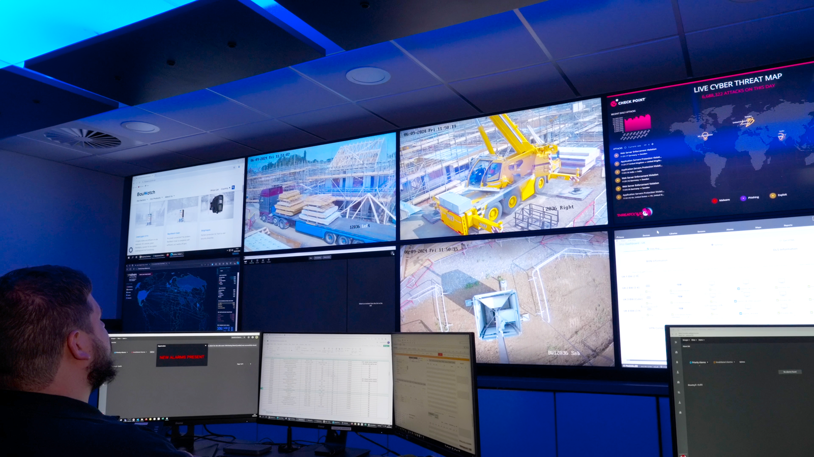
Tier 3:
Security Expert Alarm Verification
60 sec to Review, Analyse, Verify and Call police
Notes:
Only truly relevant clips are flagged and forwarded within seconds to a trained expert for final assessment

Slide 10
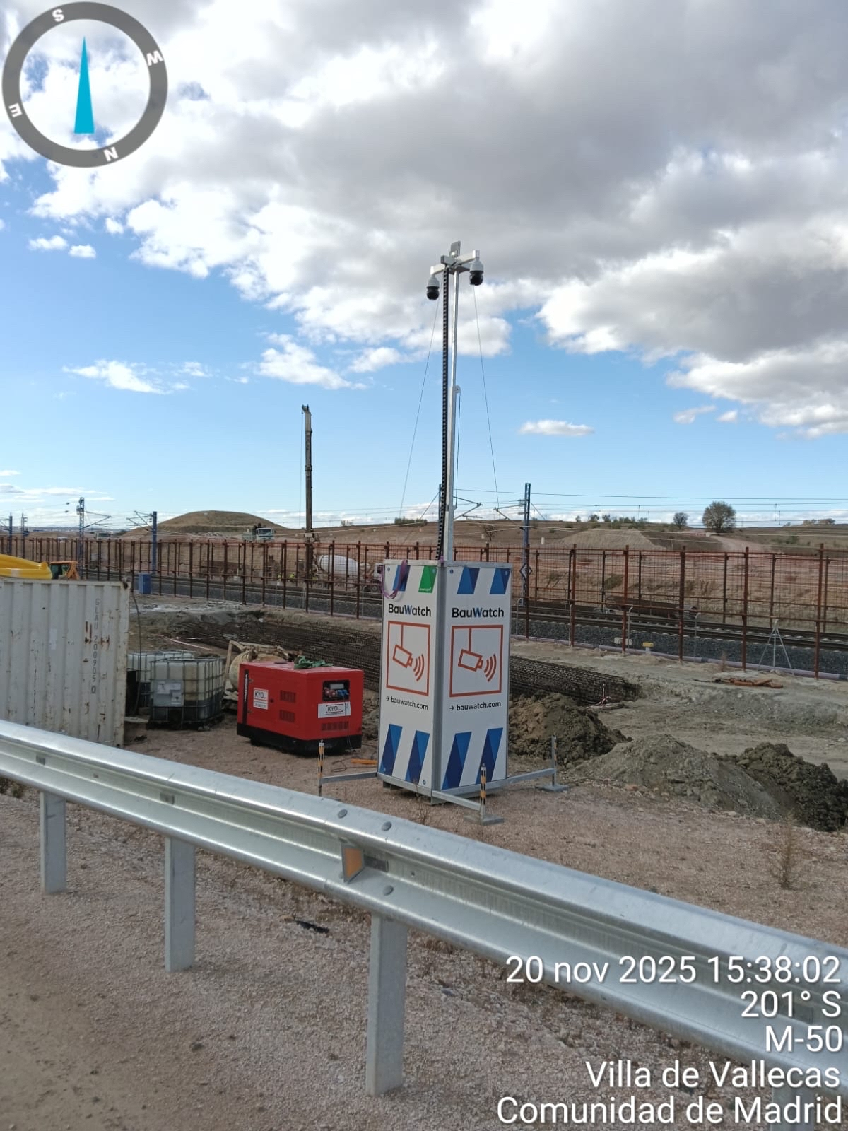
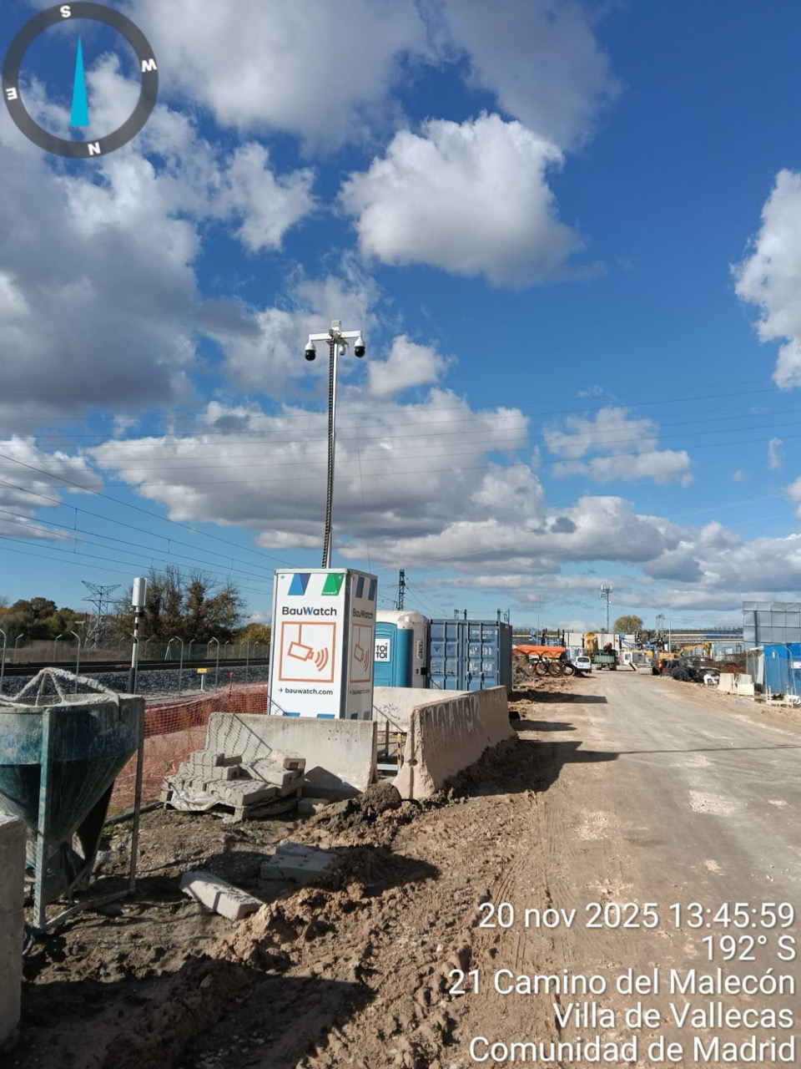
Case: UTE Conexión Levante-Barcelona
Project: Conexión Levante-Barcelona con Túnel Atocha-Chamartín
Location: Madrid Vallecas
Challenge: Very large, open-access construction area
Solution: 2 BauWatch GreenLight
4 BauWatch Solar
Duration: 36 months

Slide 11
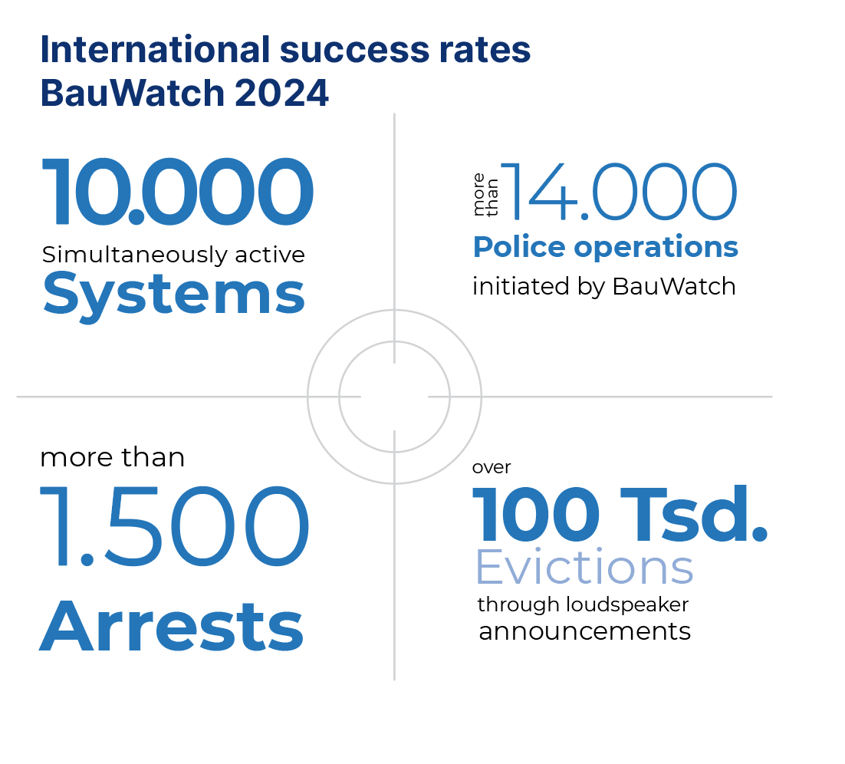
Why BauWatch?
Alarm
Statistics
Industry Expertise from the Market
Leader
    Operating for over 15 years
    More than 44.000 sites monitored
Dedicated In-house Teams
Fully Certified Alarm Centers
End-to-end Security Service
  Consulting, Security plan, Installation, Monitoring, After Service
2023
Notes:
More than 80 drivers and technicians, continuously trained on BauWatch quality and security standards – ready to serve our clients' individual needs across 22 locations in Europe
Delivering the fastest response times in the industry
Fulfilment rate: 85,000 successful evictions per year
Customised Security Solutions
Bespoke solutions through need analysis – tailored to our client's needs
Flexible contracts and pricing modules

Slide 12
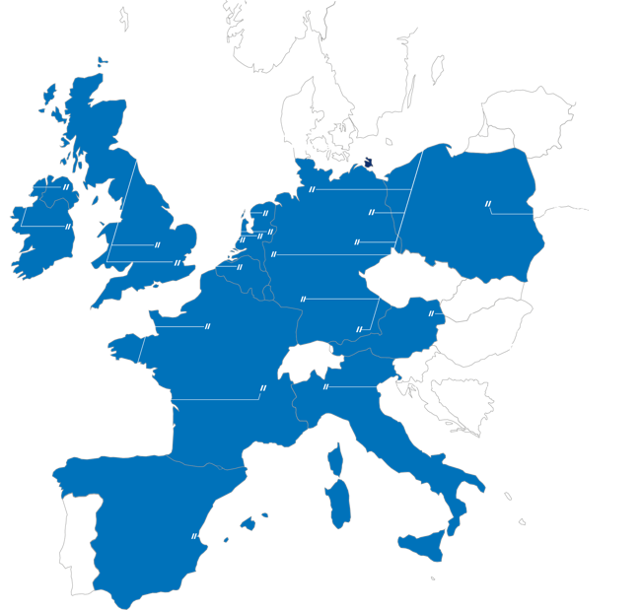
Where can you find us?
Being active in 11 countries
across Europe, no security request
is too far for us to be serviced.

Slide 13
Thank you
Ignacio González Medina
igonzalez@bauwatch.com
+34 666 759 108

